Slide 1
Welcome to South Hills
Psychiatric Rehabilitation Centre

Slide 2
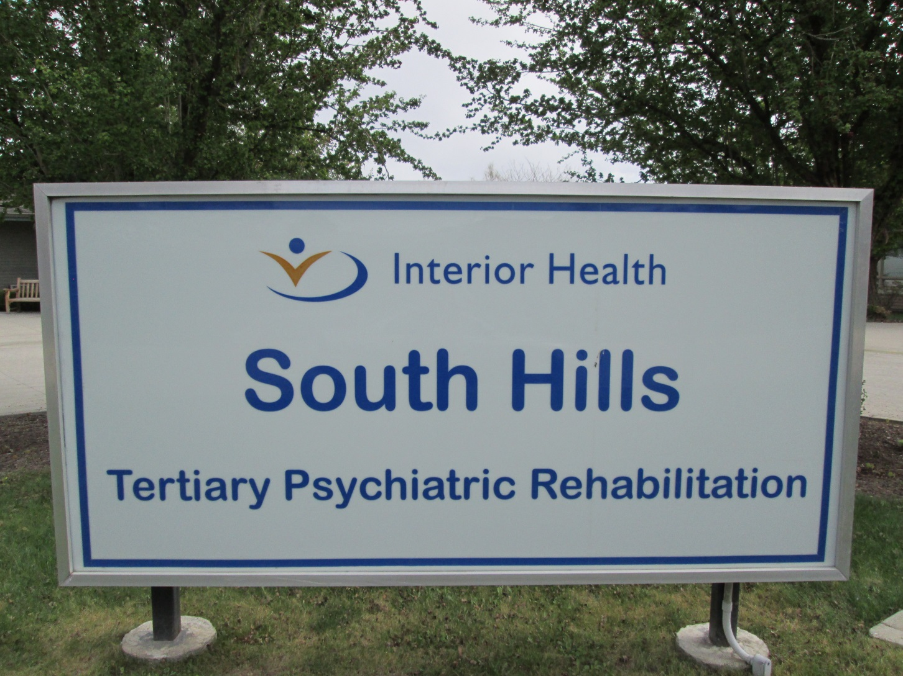
Welcome!

Slide 3
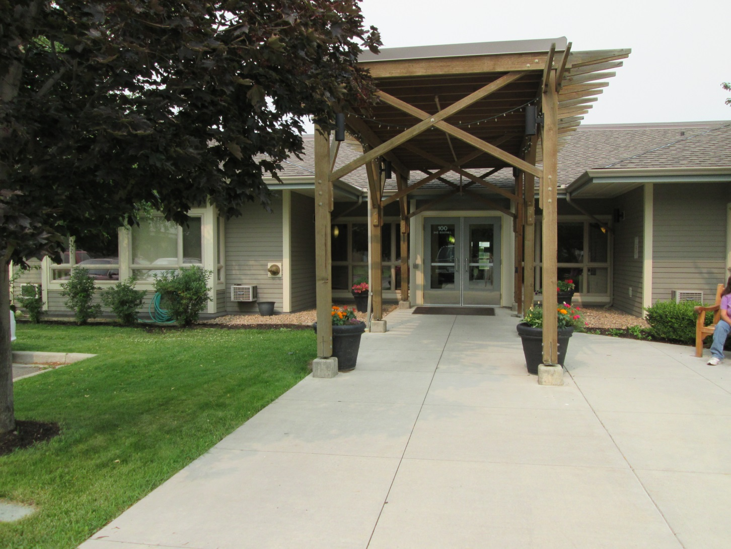
Our Front Entrance

Slide 4
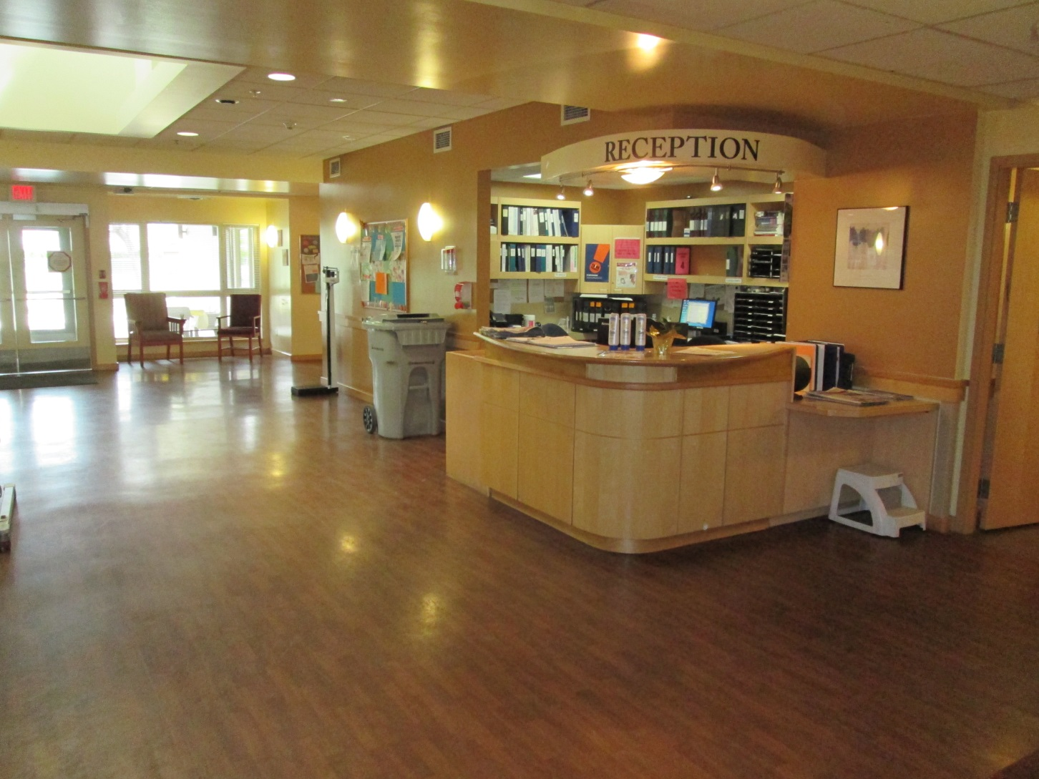
Our Lobby

Slide 5
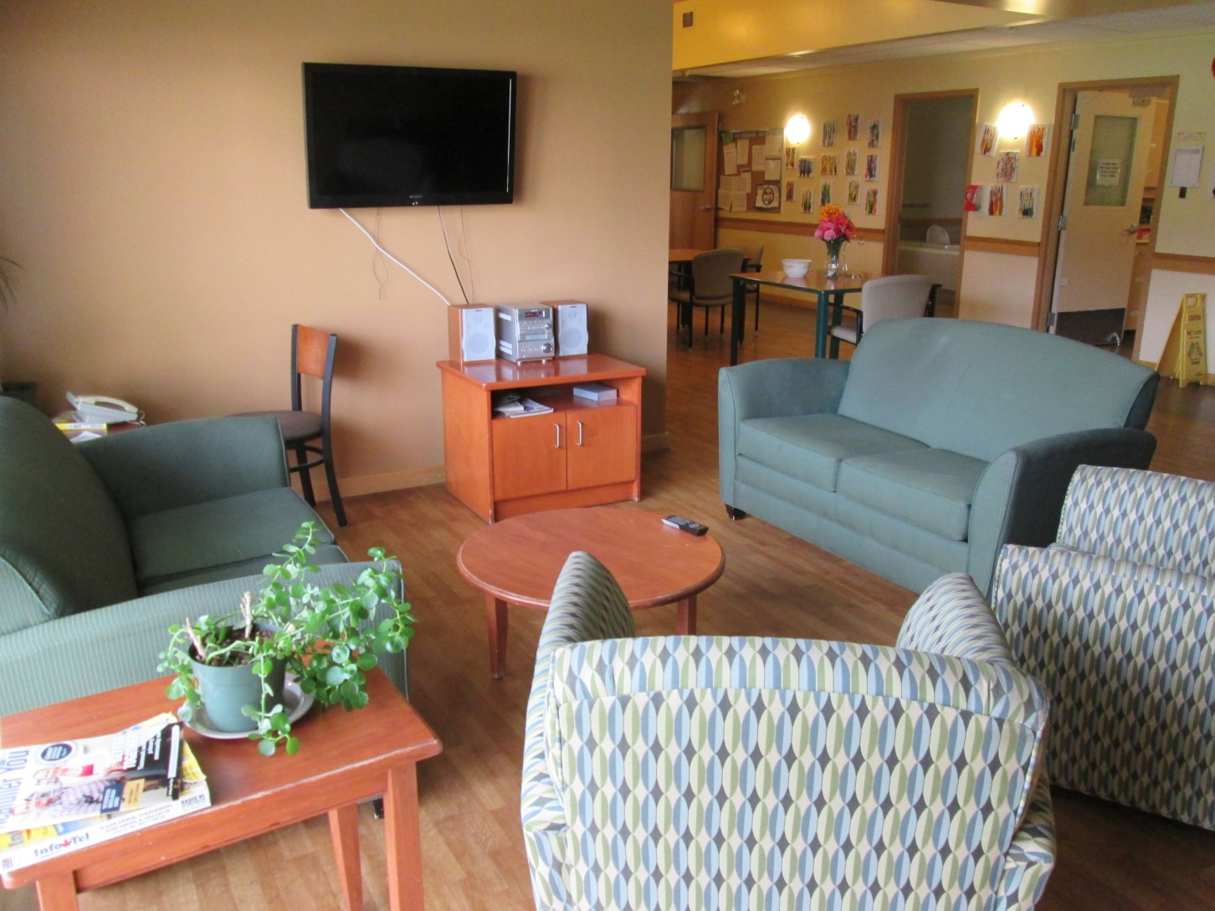
Residents’ Living Rooms

Slide 6
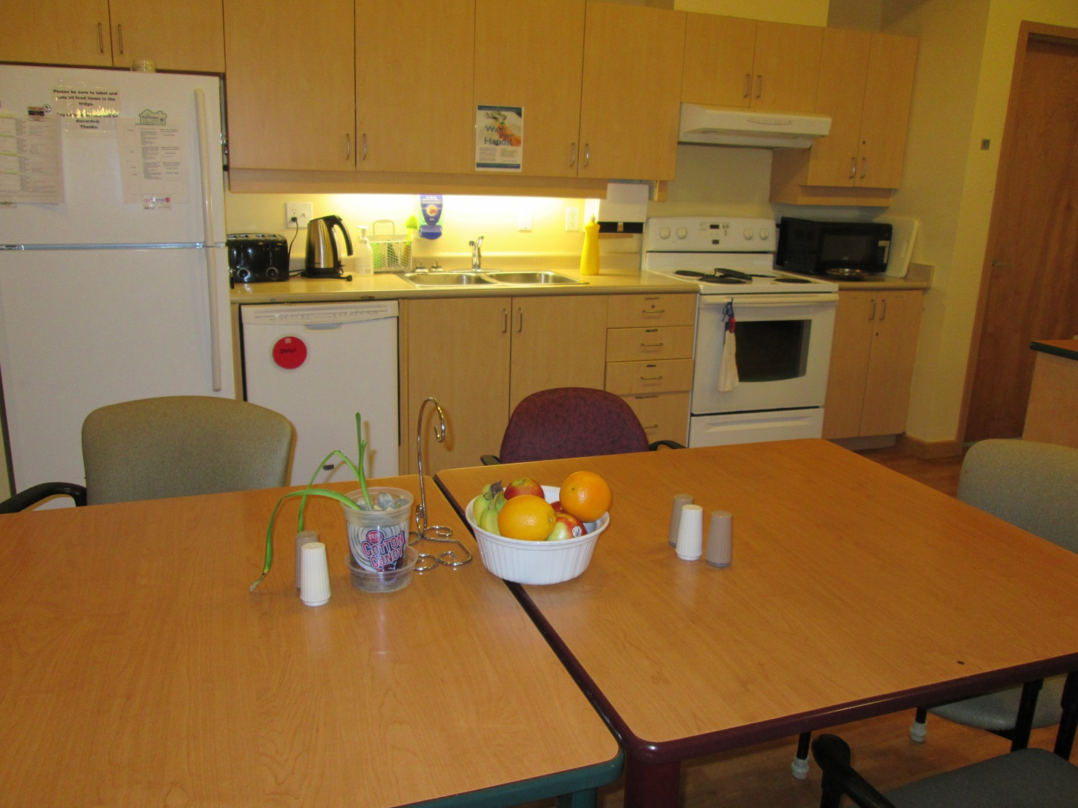
Our Apartment’s Kitchens

Slide 7
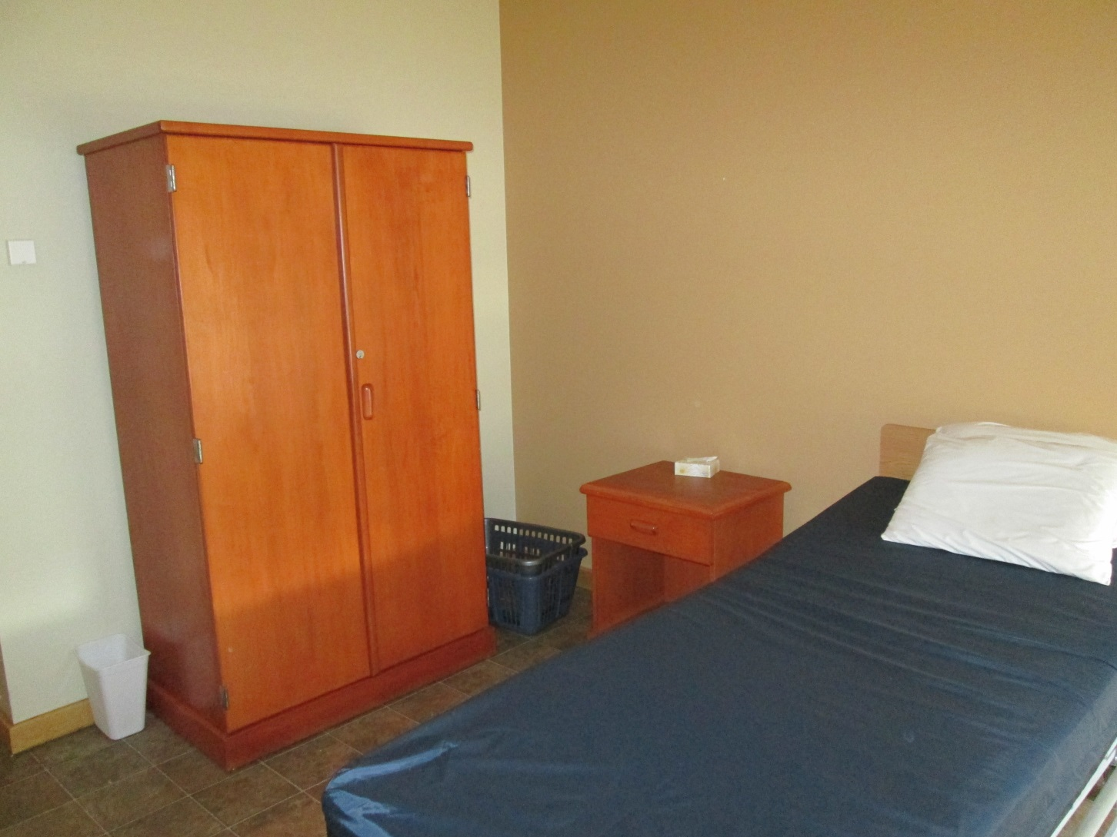
Residents’ Bedrooms

Slide 8
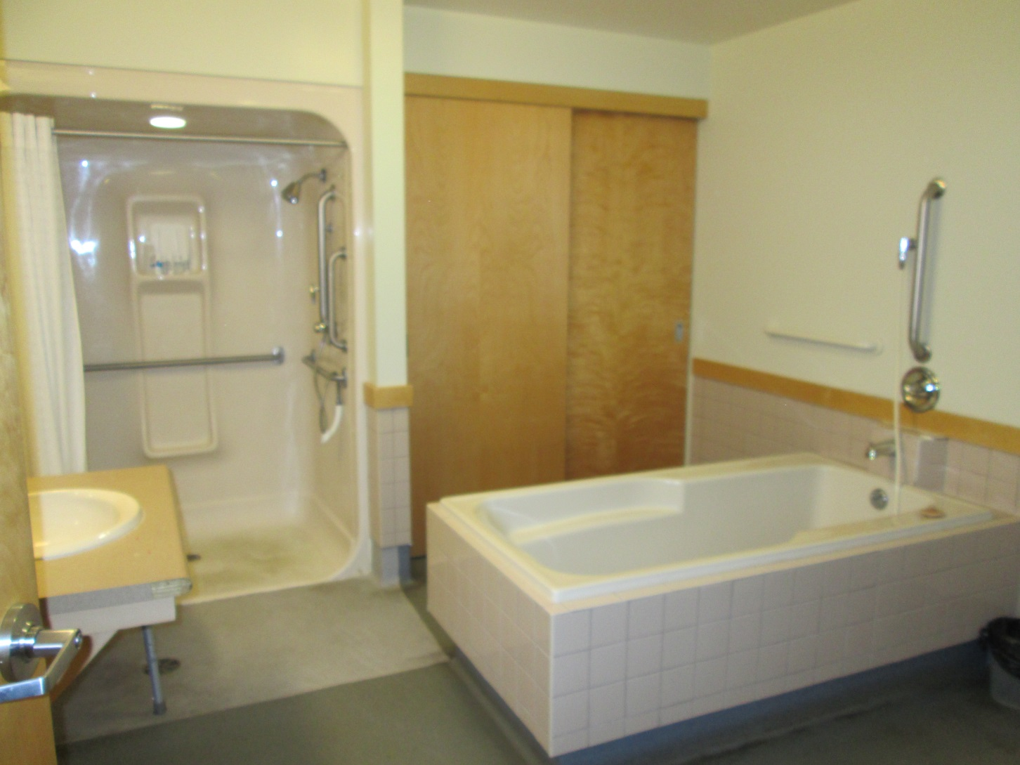
Spacious Bathrooms

Slide 9
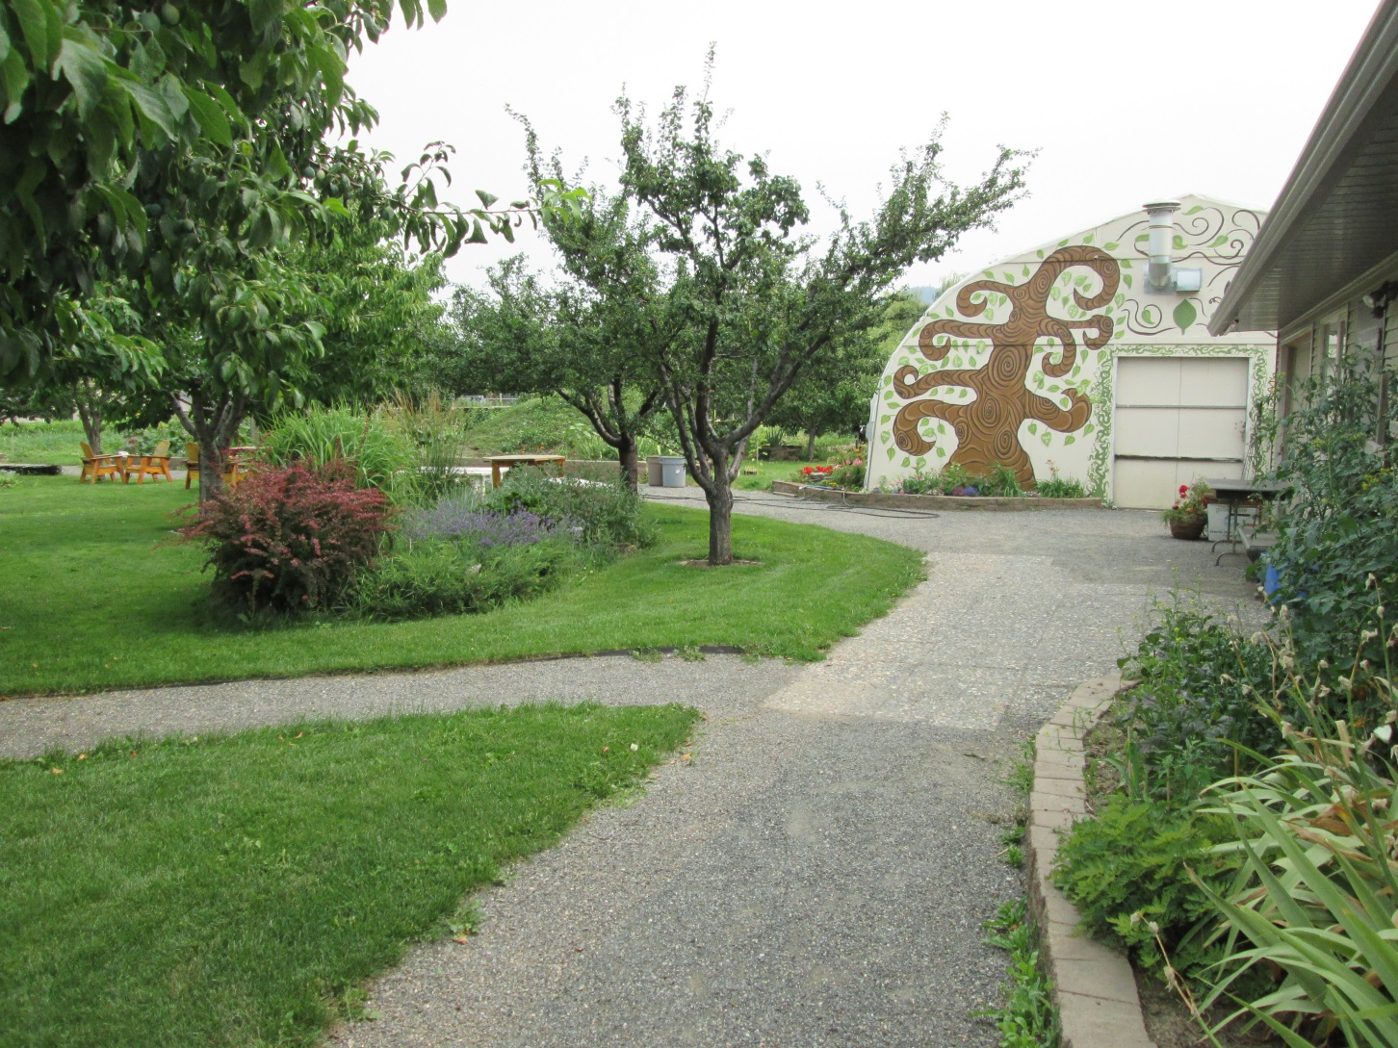
Garden Gate

Slide 10
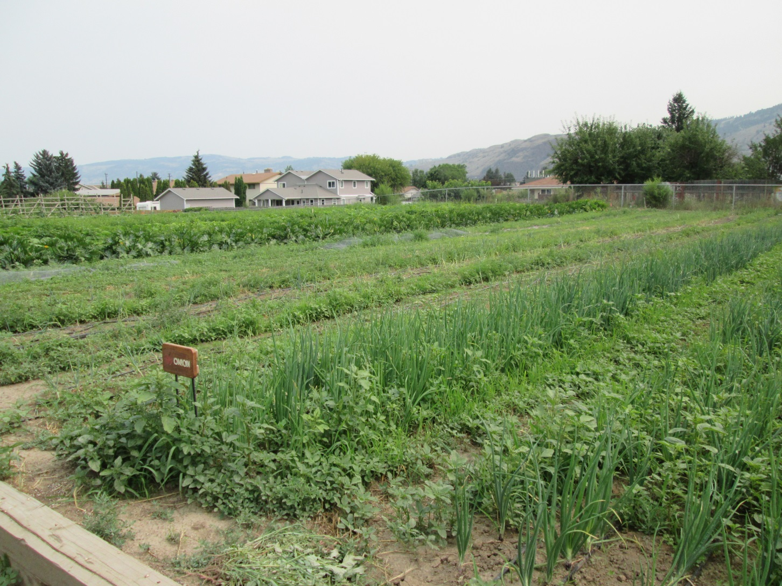
A beautiful place to work

Slide 11
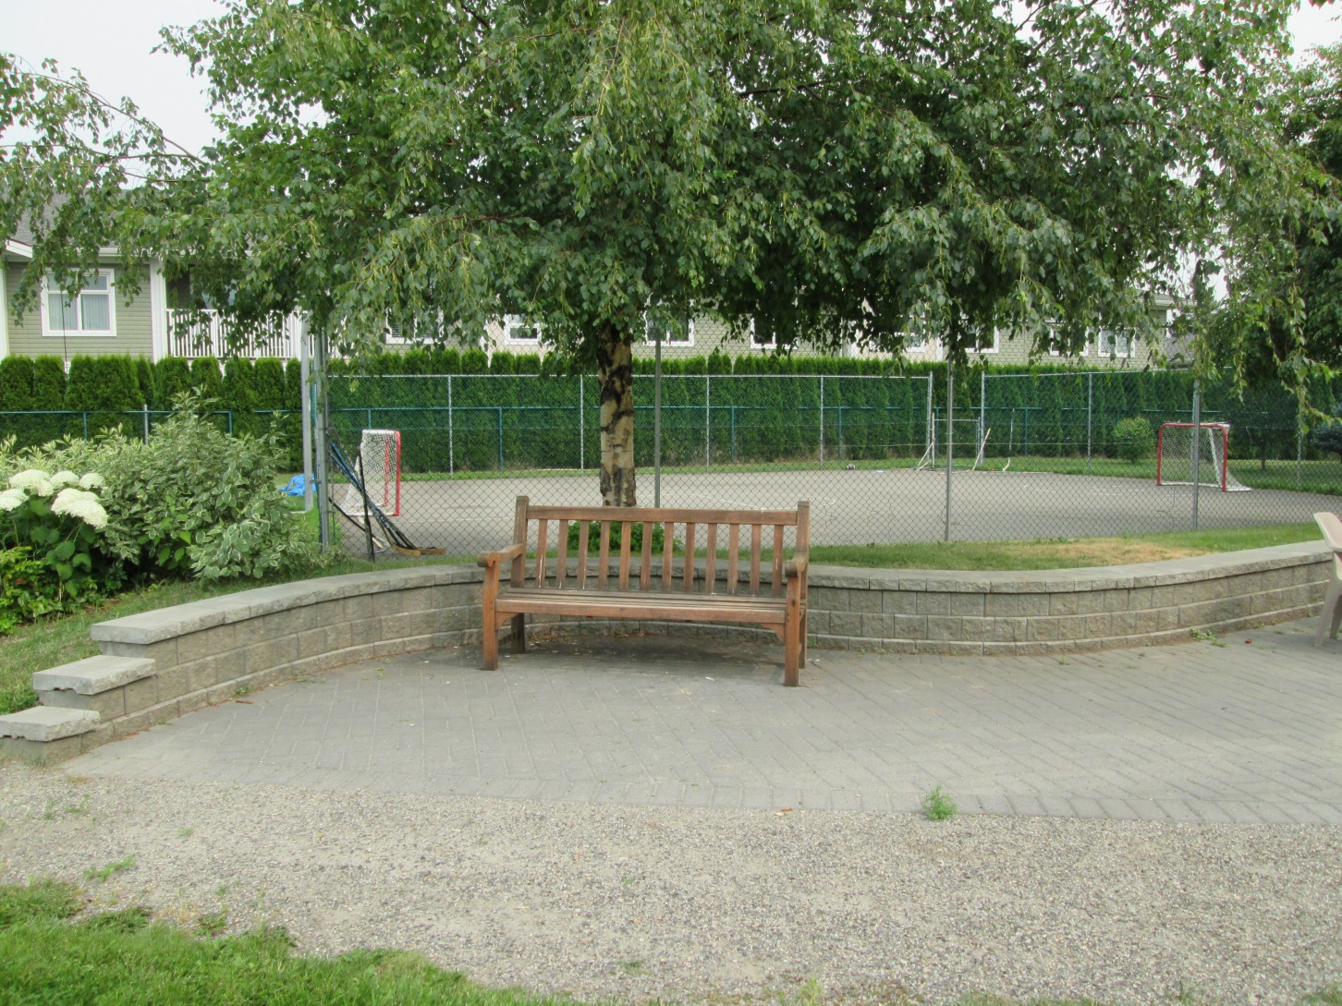
Our Grounds

Slide 12
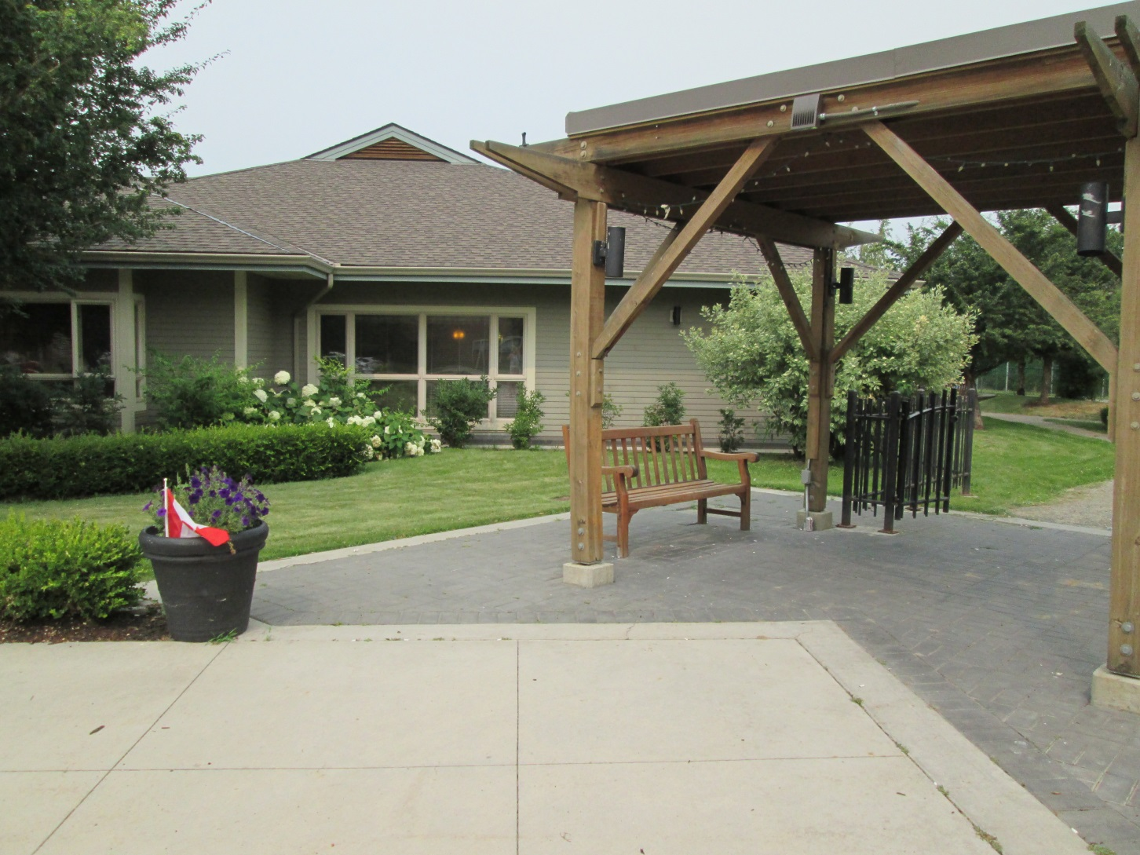
Beautiful!

