Slide 1
August 2023
Notes:
Revised 2023, 2022 and 2021 by Brenda Marsman, 2019 by Joanne Smrek and Brenda Marsman 2015 by Amber Froste and Brenda Marsman
Epilepsy and Seizure Information for Schools 7 minute video from the BC Epilepsy society https://www.youtube.com/watch?v=MZBGNVlaa2s
Video can be shown at the beginning or end or with slide 8, highlight link in slide and then use open hyperlink

Slide 2
Goal
To help increase your knowledge of:
Seizures
Epilepsy
how to best support the student with epilepsy
basic first aid procedures for seizures
Notes:
1 out of 10 people will experience a seizure in their lifetime. People can have seizures for many reasons. Having one seizure does not mean that a person has epilepsy. Almost 1 out of 100 Canadians are living with epilepsy. Each year about 18,000 Canadians will be diagnosed with epilepsy. source: Epilepsy at school | Caring for kids (cps.ca)
IH Istock image

Slide 3
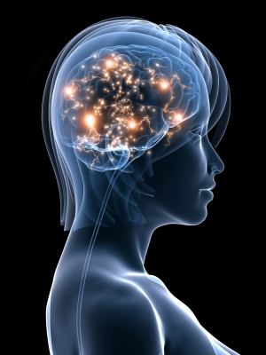
What is a Seizure?
A seizure is “a brief, temporary disturbance in the electrical activity of the brain” and may affect:
Muscle control and movement
Speech
Vision and/or eye movement
Awareness and/or behaviour
Seizures can be:
Convulsive or non-convulsive
Vary in frequency and severity
Source: BC Epilepsy Society
Notes:
Seizures are sudden bursts of abnormal electrical activity in the brain that may affect a person's muscle control, movement, speech, vision, or awareness (consciousness). There are many different types of seizures. The kind of seizure a person has depends on which part and how much of the brain is affected by the electrical disturbance that produces seizures (Seizures are divided into two main categories: partial seizures or generalized seizures).
Some seizures make a person fall to the ground in convulsions, in which the muscles stiffen or jerk out of control. Others may stare in a trance-like state, have only a few muscle twitches, or sense a strange smell or visual disturbance not experienced by anyone else. In some people, seizures happen only occasionally; for others, it may happen up to hundreds of times a day
IH Istock image

Slide 4
Signs of a Seizure
Extended blank stare
"Empty" look in eyes
Rapid blinking
Eyes rolling upward
Periods of unresponsiveness
Inability to pay attention
Repetitive (tic-like) movements of body parts, usually head, arms, legs
Uncontrollable jerking body movements
Mouth movements with a dazed look
Frothing at mouth
Loss of consciousness
Loss of body control
Dazed walking
Temporary confusion
Source: BC Epilepsy Society
Notes:
Knowing that seizures can be different and dependent on the person, here are some more common signs that someone may show when they are having a seizure. Most seizures last less than 5 minutes.
Source: BC Epilepsy Society
Further on in this power point we will review the different types of seizures you may see.

Slide 5
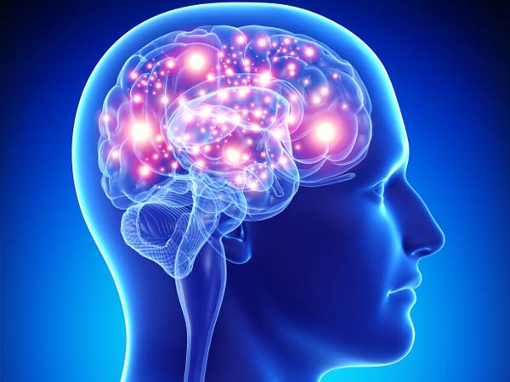
Seizures vs. Epilepsy
What is the difference?
Seizures
Often symptoms of another health problem:
diseases
fever
temporary medical, neurological or neurosurgical illness
After the person is treated (illness is resolved) the seizures do not occur again
Epilepsy
A chronic (ongoing) series of seizures, and can develop at any age.
Seizures reoccur frequently and often without a known cause.
Notes:
Sometimes a seizure is a symptom of another medical problem, such as a high fever (especially in children), a stroke, infection, low blood sugar (hypoglycemia), very low blood pressure, or a brain tumor.
People can have seizures and not have epilepsy as seizures alone can be symptoms of another health problem, often there is NO obvious explanation or diagnosis for why they happen
A seizure can be a one-time occurrence while with Epilepsy, a person can experience several different types of seizures and they can reoccur many times a day.
Source: BC Epilepsy Society
IH Istock image

Slide 6
Epilepsy
Neurological disorder that makes people susceptible to seizures
Sometimes called a seizure disorder
Can develop at any age
Seizures are chronic (ongoing and frequent)
Seizure can often happen without known cause
Many people with epilepsy experience more than one type of seizure.
Notes:
Epilepsy is not a disease, it is a symptom of a neurological disorder - a physical condition - that from time to time produces brief disturbances in the normal electrical functions of the brain. Epilepsy is characterized by sudden, brief seizures whose nature and intensity vary from person to person.
Diagnosing Epilepsy
Diagnosing epilepsy can be hard. If you think that you or your child has had a seizure, your doctor will first try to figure out if it was a seizure or something else with similar symptoms. For example, a muscle tic or a migraine headache may look or feel like a kind of seizure. The diagnosis of epilepsy typically occurs after a person has had two or more unprovoked seizures. Diagnostic tests for epilepsy can include
• Brain function (EEG)
• Brain imaging (MRI)
IH Istock image

Slide 7
Why Do Seizures Occur?
HEAD INJURY
MVAs, Sports accidents
Falls
Head trauma
BIRTH INJURY
Brain injury to fetus during
pregnancy & birth
Perinatal asphyxia
Postnatal vascular accidents
INTRACEREBRAL INJURIES
Tumours
Strokes
CONGENITAL DISORDERS
METABOLIC DISORDERS
INFECTION
Meningitis
Viral encephalitis
Measles, Mumps
Diphtheria
HEREDITY
Inherit different degrees
of susceptibility to seizures
FEVER
Notes:
Epilepsy is a disorder with many possible causes. Anything that disturbs the normal activities of the nerve cells in the brain (the neurons) can lead to seizures.
However about 70% of cases of epilepsy have no known cause. Only about 30% of cases of epilepsy can be linked to a known cause.
Seizures can be provoked or unprovoked.
Provoked seizures can be caused by:
• Low blood sugar (hypoglycemia),
• Alcohol withdrawal,
• Changes to blood sodium or potassium levels,
• An infection, or
• A head trauma, either moments before or up to a week before the seizure.
MOST provoked seizures are NOT epilepsy Source: For Educators – Epilepsy Ontario
Other known causes (shown on slide) include:
Brain injury/head trauma
Stroke
Infections that damage the brain (such as meningitis or encephalitis)
Brain tumors
Abnormalities in the brain development
Poisoning from substance abuse of alcoholism
Potential causes are thought to include:
Genetic disorders
Neurotransmitter imbalances
Gene mutations
Cell membrane abnormalities
There is no cure for epilepsy. Treatments such as medications can control seizures in many people, but about one third of people with epilepsy will still have seizures (BC Epilepsy Society , 2015)
IH Istock image

Slide 8
What can trigger a seizure?
Stress
Excessive excitement/stimulation
Excessive fluid intake
Extremely low blood sugar in diabetics
Sunlight, heat, humidity
Flickering lights
Skipping meals and poor nutrition
Illness, fever, allergies
Lack of sleep
Withdrawal from medicine, illegal drugs, or alcohol
Missed medication
Source: BC Epilepsy Society
Notes:
Triggers are situations or stimuli that increase the likelihood that someone will have a seizure. They vary from person to person and may be different or even unknown for each child:
Events that may trigger seizures include:
Stress
Poor nutrition
Missed medication
Flickering lights
Skipping meals
Illness, fever and allergies
Lack of sleep
Emotions such as anger, worry, fear and others
Heat and/or humidity
Sources: Epilepsy Canada and BC Epilepsy Society
IH Istock image

Slide 9
Types of Seizures
Focal (partial)
GENERALIZED
Occurs in PART of the brain
Occurs in the WHOLE brain
Simple Partial
Complex Partial
Tonic
Atonic
Tonic-clonic
Myoclonic
Absence
https://www.youtube.com/watch?v=MZBGNVlaa2s
Notes:
Show 7 minute video of Epilepsy and Schools here Epilepsy and Seizure Information for Schools ( highlight video link in slide and then use open hyperlink) https://www.youtube.com/watch?v=MZBGNVlaa2s
The modern system of seizure classification draws a distinction between focal/partial and generalized seizures. If the excessive electrical discharge is restricted to a given (localised) area in the brain, the seizure is termed focal/partial. If the entire brain is involved, the seizure is generalized
Focal/Partial Seizures:
Manifestations of this type of seizure of seizures will depend on the region of the brain involved in the seizure activity and are differentiated by whether the person’s normal level of awareness is retained or not. Two types: Focal Aware Seizures (Simple Partial Seizures)
• Cause no change in awareness or language
• Allow complete memory of the event afterwards
• Often called auras (sensations of heat, scents, etc.)
Focal Unaware Seizures (or Complex Partial Seizures )
• Cause a change in the person's level of awareness, language function, memory, or all three
• Appearance of seizures will depend on the part of the brain affected
• Sometimes a focal seizure can evolve into a generalized seizure
Generalized seizures can cause changes in the muscles, which is how most of these seizure types are named. There are four such types of generalized seizures that cause changes in the muscles: 1. Tonic — an increase in muscle tone; 2. Atonic — a loss of muscle tone; 3. Tonic-Clonic — an initial increase in muscle tone (tonic) followed by rhythmic jerking movements (clonic); and 4. Myoclonic— a sudden muscle jerk or jerks. Absence seizures, while considered generalized, are different in that they are characterized by a brief lapse in consciousness.
Generalized Seizures: What you may notice:
• A sudden sound, such as a cry, as the seizure starts.
• The person may fall to the floor. • The person's whole body may shake.
• Shallow and irregular breathing or lips turning blue.
• The person may vomit as the seizure ends.
• The person may lose consciousness.
• The person may lose control of bowels or bladder.
• The seizure typically lasts from a few seconds up to 3 minutes
Absence seizures are very brief (~2 to 20 seconds)
• Different, but still belong to the generalized seizure category
• Prior to 1989 these were called petit mal seizures
• Difficult seizures to identity/easy to miss What you may see:
• The student has a blank or vacant stare.
• The seizure starts and ends abruptly.
• The student's eyes may blink or roll upwards.
• Some people may exhibit chewing movements.
• There is a loss of consciousness during the seizure, but it is very brief
Source: For Educators – Epilepsy Ontario Source: BC Epilepsy Society
Link to Epilepsy in schools 7 minute video
http://www.bing.com/videos/search?q=bc+epilepsy+youtube&qpvt=bc+epilepsy+utube&FORM=VDRE#view=detail&mid=0CEF8F2AE89146877CF50CEF8F2AE89146877CF5
IH Istock image

Slide 10
Treatment
Medication
Most common
Seizures can be completely controlled in about 70% of all cases
A control, not a cure
*Goal: To use the least amount of drugs and to have the least amount of side effects
Surgery may be effective for some children
Special diet may be used in some cases
Notes:
Children diagnosed with epilepsy most likely will be taking medication. Anti-seizure drugs successfully control seizures for approximately 67% people with epilepsy who take them regularly and as prescribed.
Surgery
Can produce good control but not all children are surgery candidates
Only possible when seizures occur in a small part of the brain
70% of people who have surgery have partial to full improvement
Ketogenic Diet
High fat, low protein, low carbohydrate
Has been used since before the 1920’s
Its exact mechanism is unknown
Very rigid and difficult to administer
Restricted fluids
It works by tricking the body into reacting as if it's starving or fasting; it causes the body to burn fats rather than carbohydrates
Source: BC Epilepsy Society
IH Istock image

Slide 11
How does epilepsy affect a child at school?
When managed effectively, and with support and planning, students with epilepsy should be encouraged to participate in all school activities.
Some students may need extra support at school due to difficulties with learning, behaviour and/or mobility.
Some children may occasionally be more sleepy than usual due to a recent medication adjustment. This should be temporary.
Notes:
Social anxiety and stigma around epilepsy are common. This can often be more harmful to a student’s quality of life at school than the condition itself.
ADHD, anxiety and depression are among the most common co-occurring diagnosis associated with epilepsy

Slide 12
Classroom Considerations
Because epilepsy affects the brain, it can affect the learning process. Accommodate varied attention spans and processing speeds by making provisions for:
-access to alternative, quiet work areas
-use of clear, explicit and visual instructions
-regular breaks as needed
-scheduling important and demanding activities after breaks
-presenting 1 activity or idea at a time
-provision of notes in advance or use of technology to record lessons
-time extensions for tests and assignments
-additional means for filing in potential gaps of missed content
-consider participating in “Purple Day” in March and raising school awareness
Source: Supporting Students With Epilepsy Section 3 (epilepsyontario.org)
Notes:
Because epilepsy affects the brain, it can affect the learning process. Here are some suggestions to accommodate varied attention spans and processing speeds by making provisions for:
-access to alternative, quiet work areas
-use of clear, explicit and visual instructions
-regular breaks as needed
-scheduling important and demanding activities after breaks
-presenting 1 activity or idea at a time
-provision of notes in advance or use of technology to record lessons
-time extensions for tests and assignments
-additional means for filing in potential gaps of missed content
-consider participating in “Purple Day” in March and raising school awareness Source: Supporting Students With Epilepsy Section 3 (epilepsyontario.org)
If this fits with the schools plans, March is epilepsy awareness month in Canada. More information can be found here: Home | Canadian Epilepsy Alliance

Slide 13
First Aid
Stay calm
Time the seizure
Note the time that the seizure starts and ends
Most seizures last less than 5 minutes
Protect from harm:
Move hazardous objects out of the way
Do not put anything in students mouth
Notes:
1 in 10 people will have at least one seizure in their lifetime. Generally a seizure is not a medical emergency when someone has a diagnosis of epilepsy. Knowing proper seizure first aid will greatly help someone having a seizure. It may even save their life. Here are things you can do
A first aid poster is available from the BC Epilepsy society here: BCES_37096_poster_V3 (bcepilepsy.com)
The three basic steps to first aid for all seizures are as follow: 1. Stay Calm. 2. Time the Seizure. 3. Protect from Harm
During a seizure:
Follow the care plan
Your role is to ensure safety, call emergency help when required, begin CPR (if you are first aid trained and it’s necessary), monitor and be able to describe/record seizure activity and provide comfort and reassurance.
If the person is having a seizure and is on the ground when you arrive, put something soft under their head, move objects out of the way, (BC Epilepsy Society)
Putting something in the person's mouth may cause injuries to him or her, such as chipped teeth or a fractured jaw. You could also get bitten.
First Aid for Focal Unaware (Complex Partial) Seizures: 1. Stay Calm. 2. Time the Seizure. 3. Protect from Harm: • Evaluate the environment. • If there is a hazard, gently guide the person away from danger. • Remain with the person afterwards as needed.
Reference: BC Epilepsy Society
IH Istock image

Slide 14
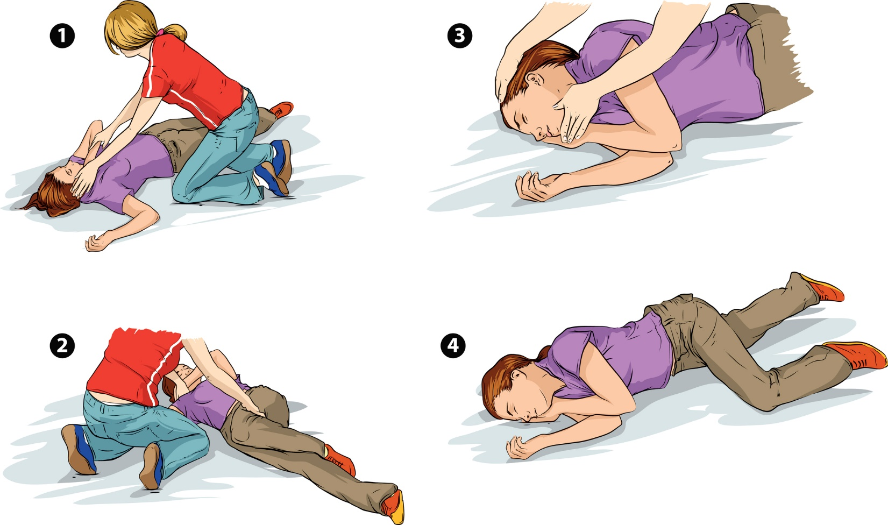
First Aid
Put the child into the recovery position
Place something soft under their head
Roll child on their side once seizure is ended and
it is safe to do so.
Loosen tight clothing, remove objects (i.e. glasses).
5. Document on the Seizure Record Form:
Describe the seizure .
How long the seizure lasted .
How the person acted immediately before and after
the seizure.
Notes:
Turn the person onto his or her side, with the mouth down, unless the person resists being moved. If the person vomits, turn the person onto their side.
Pay close attention to what the person is doing so that you can describe the seizure to rescue personnel or doctors.
What kind of body movement occurred?
How long did the seizure last?
How did the person act immediately after the seizure?
Are there any injuries from the seizure?
Time the length of the seizure.
Document Seizure on a Seizure Record Form
Source: BC Epilepsy Society
IH Isock image

Slide 15
Recovery
Reassure and provide comfort
Talk gently to comfort and reassure the student
Stay with them until they are re-oriented.
Post seizure period:
Check for injuries
Call parents if necessary/as per care plan
Allow student to change clothing if necessary
Allow student to rest or sleep
Student may complain of headache or be confused
No food or drink until the student is fully awake and alert
Have someone remain with student until fully recovered
Notes:
A person who has had a seizure should not drive, swim, climb ladders, or operate machinery until he or she has seen a doctor about the seizure.
Source: BC Epilepsy Society

Slide 16
When to call 911
Seizures do not always require urgent care.
Call 911 immediately if:
The person stops breathing for longer than 30 seconds.
After calling 911 begin rescue breathing/CPR.
The seizure lasts longer than 5 minutes. (The person may have entered a life-threatening state of prolonged seizure called status epilepticus).
More than one seizure occurs within 24 hours, the person has diabetes or is pregnant.
This is the student's first seizure; or if you don't know if the person has epilepsy.
Serious injuries have occurred
Notes:
Seizures do not always require urgent care.
In addition Call 911 immediately if :
Call 911 for assistance if any one applies: • The person is not known to have epilepsy. • A convulsive seizure lasts longer than 5 minutes. • A second seizure occurs before the person has fully recovered from the first seizure. • Regular breathing does not return when the seizure ends. • The person has diabetes. • The seizure occurs while the person is in water • The person does not regain consciousness when the seizure ends. • The person is pregnant. • The person has a serious injury.
The person does not respond normally within 1 hour after the seizure or has any of the following symptoms:
Reduced awareness and wakefulness or is not fully awake
Confusion
Nausea or vomiting
Dizziness
Inability to walk or stand
Fever
The person complains of severe pain after waking up or develops a fever within 24 hours of the seizure.
Err on the side of caution and call 911 if: • If you are concerned about the well-being of the student • If they have a seizure that is not typical for them • If the seizure lasts longer than usual • They do not recover as they normally would source For Educators – Epilepsy Ontario
Status epilepticus (SE) is a life-threatening condition in which the brain is in a state of persistent seizure. Traditionally it is defined as one continuous unremitting seizure lasting longer than 30 minutes, or recurrent seizures without regaining consciousness between seizures for greater than 30 minutes Status epilepticus (SE) is considered a neurological emergency. Left untreated (or under treated), prolonged seizures can cause permanent neurological injury or death. Rapid treatment must be initiated. http://www.epilepsy.ca/en-CA/Diagnosis-and-Treatment/First-Aid.html

Slide 17
Case Study
You notice your student seems unwell. She cries out suddenly, falls down, and her body becomes stiff and starts to shake.
What type of seizure do you
think this might be?
Tonic-clonic
Absence
Focal
In this scenario you are already aware that this student lives with epilepsy and may experience a seizure while at school
Adapted from For Educators – Epilepsy Ontario
Notes:
Here is a chance to consolidate learning
Source for this scenario : supporting students with epilepsy section 2 Supporting Students With Epilepsy Section 2 (epilepsyontario.org)
July 22 2021 received permission to adapt scenario from Epilepsy Ontario https://epilepsyontario.org/contact-us/
IH Istock image

Slide 18
Case Study
This student is likely to be experiencing a tonic-clonic seizure.
What is your next action?
Option 1:
Call 911.
Option 2:
Stay calm, clear a space around the student and protect them from harm.
Option 3:
Restrain the student and put something in her mouth to keep her from biting down.
Adapted from For Educators – Epilepsy Ontario
Notes:
Option 2 is the correct selection , given what we know about the scenario
it is important to stay with the student and offer support as follows:
-calmly sit with the student, note the time
-put something soft under her head, remove any chairs etc. that could become harmful during the seizure
-As the seizure ends, the student could vomit, place in recovery position when able
-The student could lose control of her bowels of bladder, maintain dignity for the student
-have someone remain with the student as she recovers for a minimum of 15 minutes
Classroom tips:
-ask other students to give lots of space, assure them the situation is under control, remind them not to stare or whisper (or film)
-it may be suitable to have a brief classroom debrief. Reassure the other student s that the best way to handle seizures is to be supportive and helpful
Source Supporting Students With Epilepsy Section 2 (epilepsyontario.org)

Slide 19
Family Responsibility
Provide specific information about their child
Consult with their Doctor and provide the school with an annual Medical Alert Planning Protocol
Supply labelled medications
Make treatment decisions
Ensure student wears a Medic Alert identification at all times
Communicate with the school especially when there is a significant medical change with the student
Notes:
It is very important for students with epilepsy that:
-Medical Alert Planning and Request for Medication forms (forms provided by the school) have been completed by the parents and the doctor and returned to the school (visit the interior health web page Medical Conditions at School page for more information) seizure log may be provided by the family
-medication is labelled for the student, and has not expired. Consent to administer medication at school has been completed
-school personnel as well as the student have had education about epilepsy and seizures and are aware of the care needed for the student in case of an emergency.
-the student wears their Medic Alert identification
IH Istock image

Slide 20
School Responsibility
Ensure that school staff are aware of :
which students have seizures
seizure management protocol and seizure first aid
School District policy regarding medical conditions at school
Medical Alert Planning and Request for Medication forms have been received from the family
Safely store the student’s labelled medications
Document seizures in a seizure record
Communicate with the family
Notes:
Students with epilepsy need understanding which includes an inclusive attitude, respectful language and supportive actions. It is suggested that the students picture/ care protocol be kept in a confidential location so that non-school personnel using school facilities (i.e. afterhours) are not able to view this information
It is very important for school staff that:
-they are aware of (see above #1) Medical Alert Planning and Request for Medication forms have been completed by the parents and the doctor and returned to the school (visit the Medical Conditions at School page for more information) , a seizure record (form or book) has been received from the family if needed
-medication is labelled for the student (and has not expired) and stored safely
-school personnel as well as the students have had education about epilepsy and seizures and are aware of the care needed for the student in case of an emergency.
-The student wears their Medic Alert identification bracelet
As far as documenting,: Pay close attention to what the person is doing so that you can describe the seizure to rescue personnel or doctors.
What kind of body movement occurred?
How long did the seizure last?
How did the person act immediately after the seizure?
Are there any injuries from the seizure?
Time the length of the seizure, if possible.
http://www.bing.com/videos/search?q=bc+epilepsy+youtube&qpvt=bc+epilepsy+utube&FORM=VDRE#view=detail&mid=0CEF8F2AE89146877CF50CEF8F2AE89146877CF5 7 minute on epilepsy in schools if not shown earlier
IH Istock image

Slide 21
Questions ?
For more information visit the Medical Conditions at School page on the Interior Health website
Notes:
Medical Conditions at School | School Health | IH (interiorhealth.ca)
Show video if not done at beginning or at slide 8: https://www.youtube.com/watch?v=MZBGNVlaa2s BC Epilepsy Society
References from: BC Epilepsy Society
Resources
Epilepsy Ontario Supporting Students With Epilepsy Section 2 (epilepsyontario.org)
BC Epilepsy Society Resources
BC Epilepsy Society posters on Seizure Types and First Aid and First Aid for Seizures
BC Epilepsy Society 7 minute school video: Epilepsy and Seizure Information for Schools : https://www.bing.com/videos/search?q=bc+epilepsy+youtube&qpvt=bc+epilepsy+utube&FORM=VDRE#view=detail&mid=0CEF8F2AE89146877CF50CEF8F2AE89146877CF5
BC Epilepsy Society Tips Understanding Students with Epilepsy Tips for Teachers
Canadian Pediatric Society Information for Epilepsy at school Caring for kids (cps.ca)
IH Istock image

