Slide 1
Agency
Health Care Providers IPAC Onboarding
Infection Prevention and Control
For more information contact IPAC@interiorhealth.ca
December 2024
Notes:
​

Slide 2
OBJECTIVE
To provide Infection Prevention and Control orientation to agency and travel health care providers in Interior Health.
Notes:
Orientation for Agency Nurses is often short and sweet. This powerpoint presentation focuses on IPAC essentials for agency and travel nurses before they begin work in an IH facility.
Topics reviewed in this presentation include:
Infection Prevention and control resources
Point of Care Risk Assessment ( PCRA)
Hand Hygiene
Additional Precautions
Aerosol Generating procedure ( AGMPs)
Donning and Doffing ( PPE)
ARO Screening
Special indicator

Slide 3
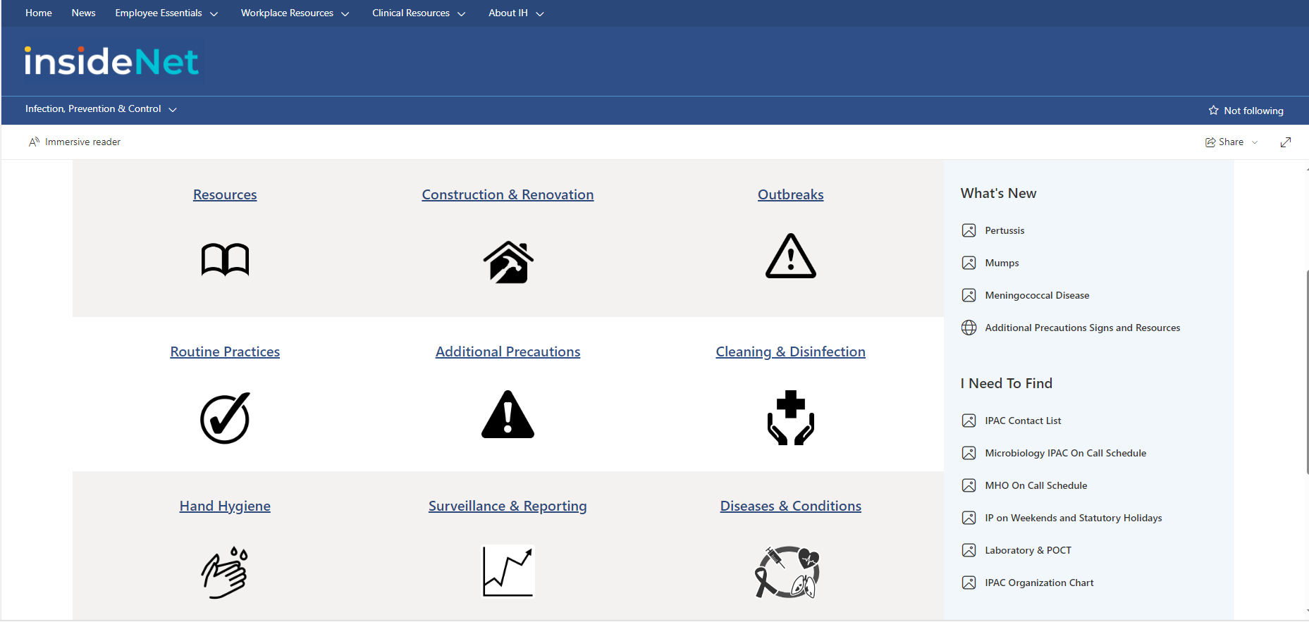
Infection Prevention & Control Manual
Notes:
Explain:​
The infection control manual is found on the InsideNet​
There are many tools available including specific diseases or conditions to ensure you are using the correct additional precautions, and many other resources.
Contact:
To reach an Infection Preventionist- Contact info located on IPAC home page, call local or cell. Check with your site to see how to contact your infection preventionist by vocera.
​
Educator Task:​
CLICK THE PIC to show infection prevention and control resources on the live site​.
Be sure to demonstrate
Diseases & Conditions (please show Disease & Conditions table) “If you are at work, and we are not available here is the tool that we would use if you had a question… Can search by condition / clinical presentation will tell you the type and duration of precautions; also lists by specific infectious organism” This is our BIBLE.
Additional precautions
Information for patients and families: pamphlets to print and share with families can be found under the specific disease you are looking for.

Slide 4
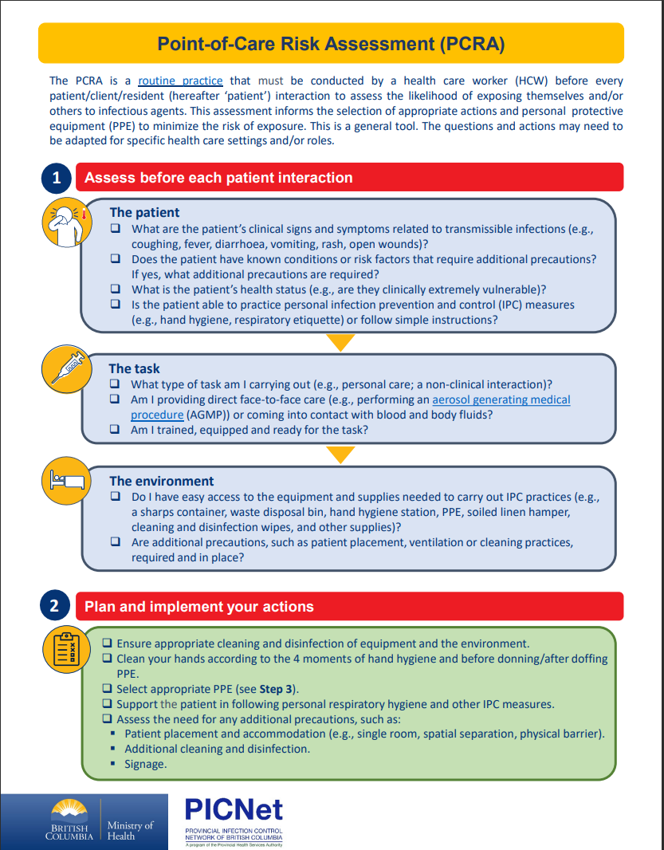
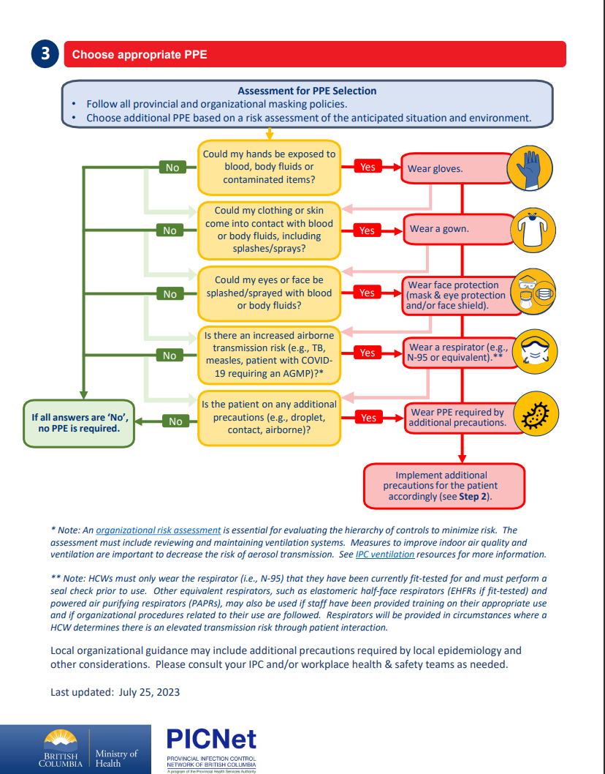
Point of Care Risk Assessment(PCRA)
Notes:
Explain:​
​Deciding which Routine Practices to use in any situation is done by doing a Point of Care Risk Assessment (PCRA). A Point of Care Risk Assessment must be done by all health care providers before every interaction with a patient or their environment, to determine which measures are required to provide safe care and prevent the transmission of microorganisms or bad bugs during that interaction.
A PCRA involves assessing the Task, Environment, and Patient
1. The task- this involves assessing what you are planning to do and how you will interact with the patient. For example, are you going to be irrigating a wound and there’s the potential for splash. Or are you dropping off a meal tray and need to touch the patients belongings on their bedside table?
2. The environment- this includes assessing the risk of the environment that the patient is in. Is this a shared room, private room, or negative pressure room?
3. The patient- you should assess how the patient is presenting or behaving. For example, does the patient have an uncontrolled cough or vomiting and diarrhea?
After doing a Point of Care Risk Assessment you will be cued for which infection prevention and control measures you should take. This can include doing hand hygiene, wearing PPE, source control, or other environmental controls.

Slide 5
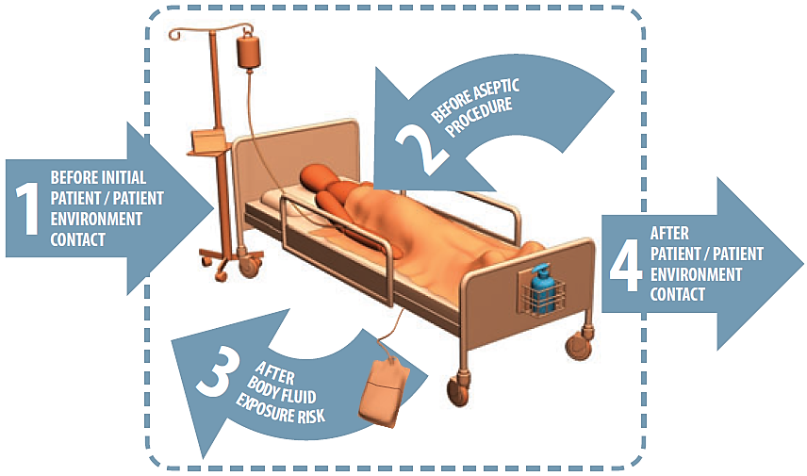
The 4 Moments for Hand Hygiene
Audit Results are on the InsideNet!
Notes:
Explain:​
Hand hygiene is the most effective strategy to prevent infections, as a significant amount of health care associated infections are caused from cross contamination of health care provider’s hands. Proper hand hygiene practices will help keep our patients and ourselves safe!​
The 4 Moments for Hand Hygiene are:​
1. Before initial contact with the patient or their environment
2. Before aseptic procedure
3. After blood/body fluid exposure risk
4. After contact with the patient or patient environment
Gloves:
Gloves do not replace hand hygiene !
Remember that you must clean your hands before donning and after doffing gloves. Your own normal flora grow to higher quantities due to the dark, warm and moist environment of the glove. Gloves are also susceptible to rips and small tears which may go unnoticed and there are no guarantee's that the glove is without micropores.​
You will be audited for proper hand hygiene practices on your units (the audits will only cover these 4 moment's). ​

Slide 6
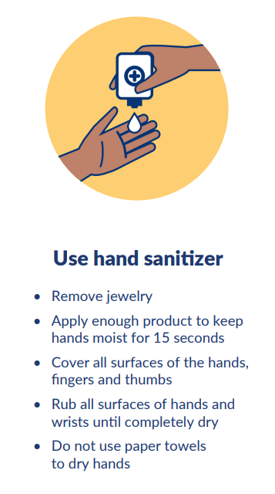
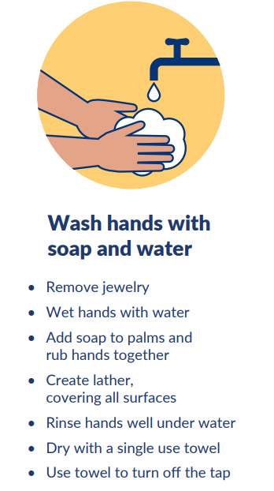
Methods of Hand Hygiene
Alcohol Based Hand Rub (ABHR)
VS
Soap and Water
Notes:
Hand hygiene can be done using Alcohol Based Hand Rub (ABHR/ hand sanitizer) or soap and water
ABHR is the preferred method of hand hygiene and kills microorganisms on contact and is easily available.
Soap and water removes dirt and should be used over ABHR when hands are visibly soiled, or during a CDiff or Norovirus outbreak.

Slide 7
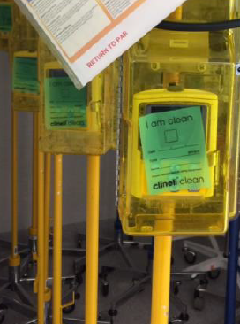
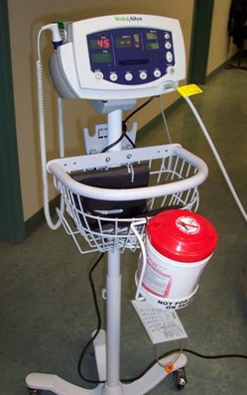
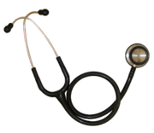
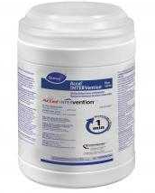
Cleaning & Disinfection
Cleaning is the physical removal of invisible & obvious foreign matter
Disinfection is the application of a solution followed by wet contact time, followed by air-drying that kills most bugs
Cleaning & Disinfection is EVERYONE’S Responsibility!
Notes:
Cleaning and disinfection is everyone’s responsibility. This is another important strategy to break a link in the chain of infection and prevent the transmission of microorganisms between patients. We clean hotels but we clean & disinfect in all healthcare settings.
Cleaning is the physical removal of invisible and visible foreign matter. Disinfection is the application of a solution to kill most bugs. Both steps require friction (rub and scrub), a minimum wet contact time with the disinfecting agent, and finally air drying.
All equipment should be cleaned AND disinfected after use. Many units use the motto “green is clean” to help differentiate which equipment is clean & disinfected and ready for use. After cleaning, disinfecting, and storing equipment, use green tape or a green sticky to communicate that it is safe to use on another patient or place in a dedicated labelled clean zone

Slide 8
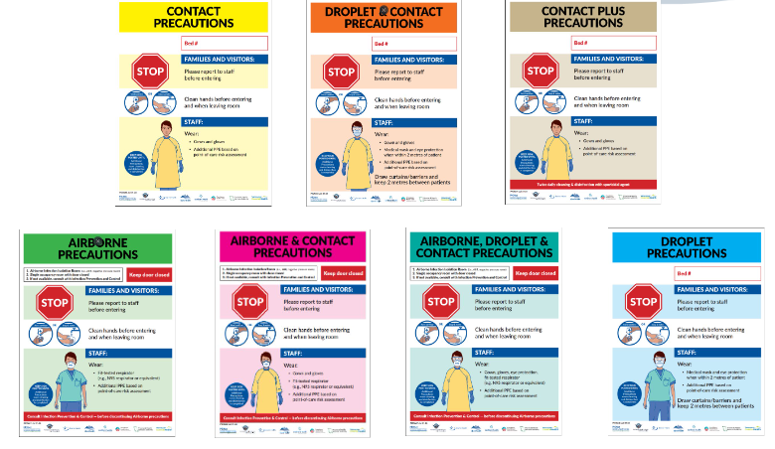
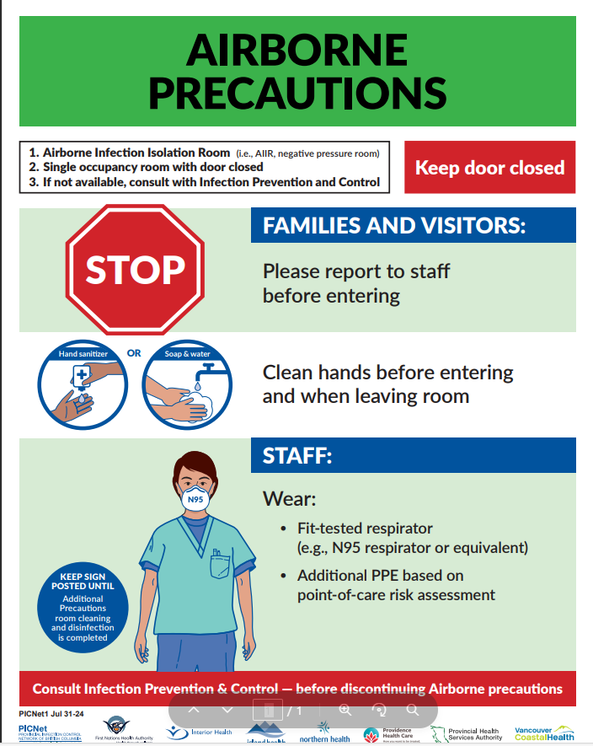
Additional Precautions
Notes:
Additional Precautions signage available at IH.
Follow PPE demonstrated on the sign.
If you have any questions about associated practices with a specific additional precaution sign ( i.e. how to transport patient on these precautions) refer to corresponding guideline on the infection prevention and control page on InsideNet.
It is the responsibility of the health care provider to ensure signage is VISIBLE to anyone who may enter the room. Signage to be posted at the entrance to patient room, or curtained bay.
Can you give me an example of the proper signage for a patient that is positive for Cdiff? For Measles?

Slide 9
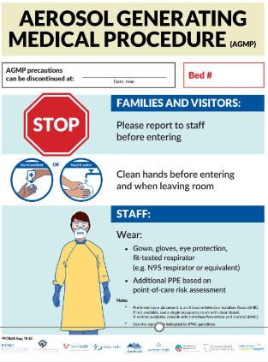
Aerosol Generating Medical Procedures
Infection Control (bccdc.ca)
for updated list of AGMP Medical Procedures
Notes:
When a health care provider is working with patient(s) on droplet or droplet contact precautions and an AGMP procedure is in place then AGMP guidelines are followed from Infection Control (bccdc.ca) and an N95 mask shall be donned.
If you have questions about what is considered a Aerosol Generating medical procedure( AGMP) --- refer to most up to date list on BCCDC webpage.

Slide 10
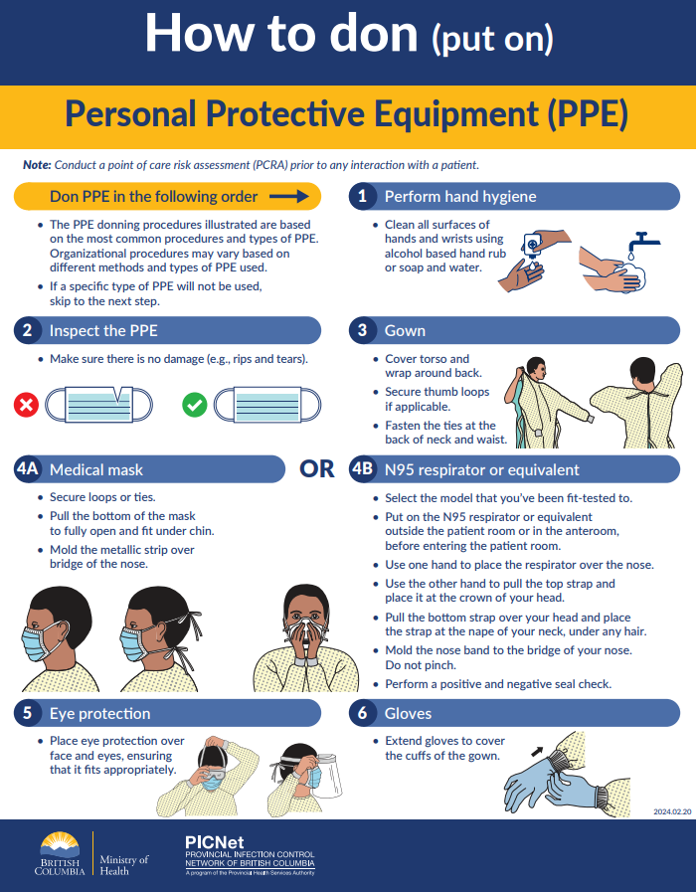
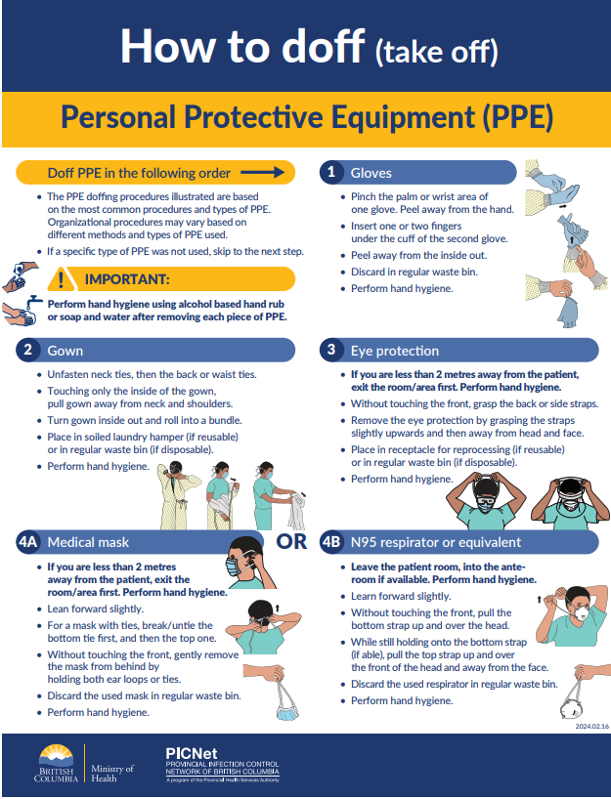
Donning PPE
Doffing PPE
Notes:
Explain:
Using personal protective equipment or PPE will protect your patient, decrease your exposure risk, and prevent the transmission of infectious bugs
PPE that is often used includes, gloves, gowns, medical masks, eye protection, and in some instances fit tested N95 respirators.
There is a specific order that PPE should be put on and taken off. When you doff or take off your PPE, it is especially important to do this with hand hygiene in between every step. This will help to prevent self-contamination during the process.
Review order in Donning and Doffing PPE posters​
-posted on the units​ and part of the mobile PPE carts.
​

Slide 11
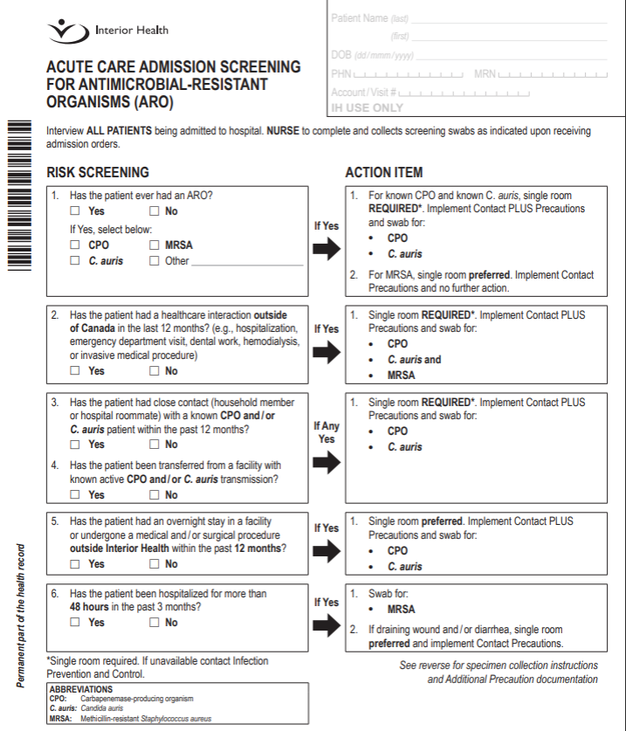
ARO Screening
Interview ALL PATIENTS being admitted to the hospital.
Notes:
To prevent transmission of ARO's in all healthcare settings, including acute care and long term care​.
The screening tool is used to determine patient risk factors and identify necessary actions for all admitted patients, pre-surgical screening, surgical patients with unplanned admission, and patient repatriation's​
Interview ALL PATIENTS being admitted to hospital. NURSE to complete and collects screening swabs as indicated and upon receiving admission orders ​

Slide 12
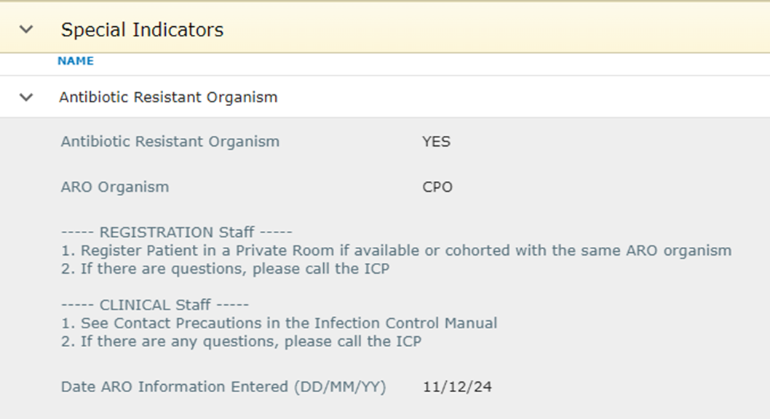
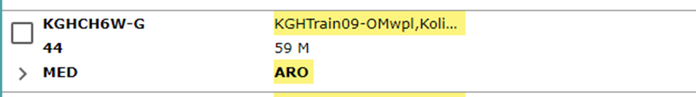
Special Indicators on Meditech
Notes:
Special indicators for infection prevention and control at IH are:
ARO: an internal ARO alert is entered into a patients electronic record by Infection Preventionist for all confirmed positive ARO (MRSA?) patients
MDR: an MDR alert is entered in the patients electronic record by the Infection preventionist for all confirmed CPO and/ or C. auris patients.
EXP : an EXP alert is entered in patient’s electronic record by an Infection preventionist for patients exposed to CPO and/ or C. auris
Bring to attention the different indicators that are on meditech and the importance of proper bed placement and additional precautions that may be needed​
Explain how to expand the indicator tab if there are greater then 4 indicators. There is an ellipsis following the four indicator that will highlight all indicators
If you identify a special indicator on a patient profile and would like more information, open the patient chart → Other Clinical→ Special Indicators

