Slide 1
Environmental Services and Infection Prevention and Control
For more information contact IPAC@interiorhealth.ca
September 2025
Notes:
​Hello and welcome to this education session on Infection Prevention and Control!
There are many people that make up our health care team whether it’s in an urgent care center, a large hospital or a rural Longterm Care Facility.
All team members are involved with staff, patient and visitor safety.
Environmental Services and the work you all do is vital to keeping everyone safe. Infection Prevention and Control is everyone’s responsibility, but we understand the impact of your role and it is important that you know that what you are doing here does make a difference!

Slide 2
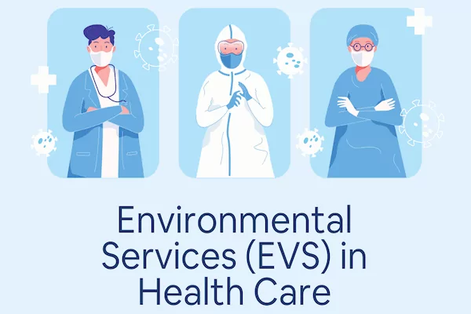
Objectives
Provide standardized education on Interior Health Infection Prevention and Control (IPAC) practices for Environmental Services (EVS) Staff
Notes:
Read slide
Our goal is to provide the same education to all staff throughout all IH sites whether in-person or remotely.
Let’s learn from each other and raise the bar for excellence in patient care!

Slide 3
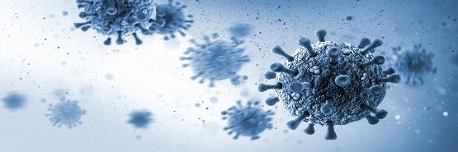
Topics to Cover
Chain of Infection
Routine Practices
&
Point of Care Risk Assessment
Hand Hygiene
Personal Protective Equipment (PPE)
Cleaning and Disinfection
Additional Precautions
Donning and Doffing
IPAC Resources
Notes:
There are many areas that involve an IPAC component, these are some of the key infection prevention and control measures we will discuss today.

Slide 4
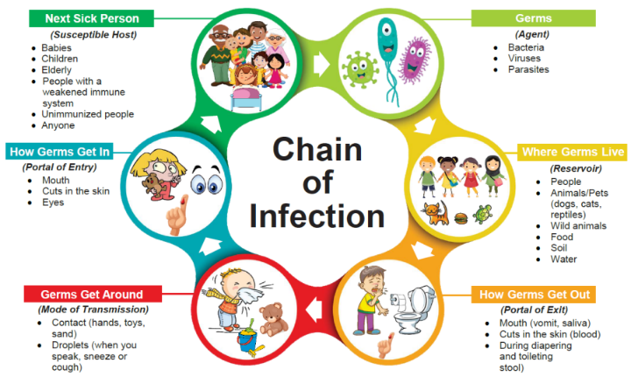
The Chain of Infection
Breaking
ANY link of the chain can stop the spread of infection
Notes:
Review the Chain of Infection pictured in the slide. Think about how germs can enter our bodies? How do germs leave our bodies? Why do some people get sick, but other don’t? (depends on general health, some people are more at risk for illness if they have other health issues ie. Cancer, treatment for HIV, certain medications, or being very young or elderly.)
So how do we stop the spread? By breaking the chain.
Our Infection Prevention and Control (IPAC) processes are designed to break the chain—**and stop germs from spreading.
For example, to interrupt the Mode of Transmission (how germs travel), we use:
Routine Practices
Hand Hygiene
Cleaning and disinfecting environmental surfaces
Additional Precautions
By attempting to break the chain at different levels – the risk of spreading micro-organisms can be decreased, the more measures we apply – the more we lower the risk

Slide 5

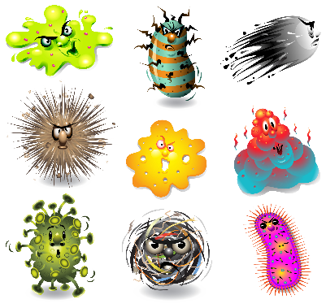
Did You Know?
80% of all common infections can be spread through the environment (air, water, food, high touch surfaces)
Diarrhea
Flu-like Illness
Cold
Notes:
We talked about portals of entry earlier – ways germs can get inside our bodies. For HCP's, these are mainly our mouth, nose and eyes.
Have you ever paid attention to how many times you touch your face?
Every time you touch your face – germs can enter! Studies have determined that people touch their face anywhere from 23 – 50 times per hour!
How Frequently Do We Touch Facial T-Zone: A Systematic Review – PMC

Slide 6
Routine Practices
Used by:
All Health Care Providers
for ALL persons
in All settings
All the time
Notes:
It is important to remember that Routine Practices should be used by everyone, all the time.
We will discuss this more in-depth in the next 3 slides.

Slide 7
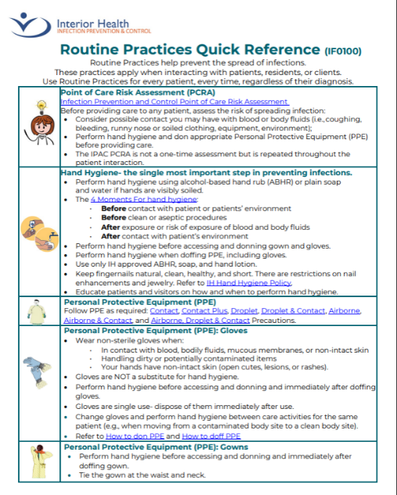
Routine Practices
Point of Care Risk Assessment
Hand Hygiene
PPE
Gloves, Gown, Mask/Eye
Notes:
This is a Quick Reference Tool located on The Infection Control Website. It’s a good idea to familiarize yourself with this webpage and the resources available – which we will show on another slide.
healthbc.sharepoint.com/sites/IPCPortalIH/Shared Documents/Forms/All.aspx?id=%2Fsites%2FIPCPortalIH%2FShared Documents%2FRoutine Practices Quick Reference%2Epdf&parent=%2Fsites%2FIPCPortalIH%2FShared Documents
Routine practices are the basic practices we do every day, like covering our mouths when we sneeze or cough and washing our hands after going to the bathroom.

Slide 8
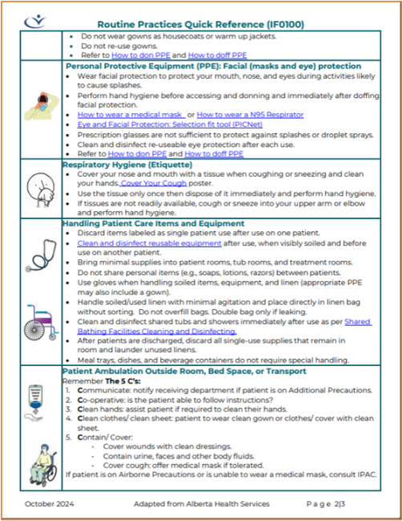
Routine Practices
Respiratory Etiquette
The 5 C’s
Patient Care Items and Equipment
Notes:
Routine practices include assessing a patient, yourself, the task and the environment – similar to a Point of Care Risk Assessment that we will review in a couple of slides.
These are more like the tasks we do by habit, for example:
Respiratory Etiquette:
Avoiding touching face while cleaning and disinfecting rooms
Covering cough/sneezes and performing hand hygiene after using a tissues
Patient Care Items and Equipment:
> You are unsure if your colleague has cleaned and disinfected an item, and there is no green tape to indicate “ green is clean” so you clean and disinfect the equipment again.
The 5 C’s:
> you hear a patient coughing a lot (no sign posted), so you decide to wear a mask with a visor
> you hear a patient say they are going to get themselves a blanket: and you offer to get it for them (to avoid patient’s contaminating the clean linen – as they often do not wash their hands before)

Slide 9
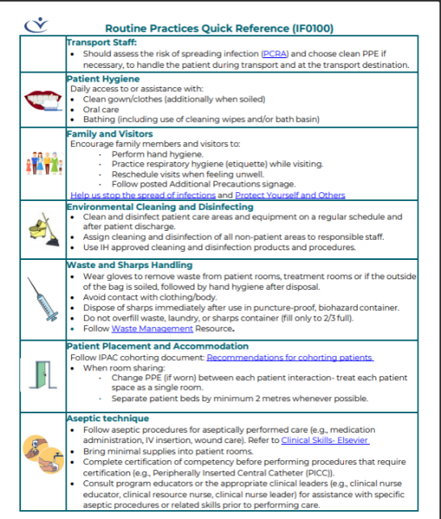
Routine Practices
Transport Staff
Visitors
Patient Hygiene
Patient Placement
EVS
Notes:
What PPE do you need to do a regular room clean?
Answer: a regular room clean only requires you to wear gloves, BUT is important to use them appropriately which we will cover in a future slide
Environmental Services [IH] - Home

Slide 10
Point of Care Risk Assessment (PCRA)
Task
Environment
Patient
Other
Additional Precautions
Notes:
Explain:​
A Point of Care Risk Assessment determines what practices are needed - such as timing of Hand Hygiene, Education, Source Control (masking a patient), Environmental Controls (Negative Pressure Room) or Personal Protective Equipment’
​
Some examples of a point of care risk assessment include:​ (adapt examples according to audience)
1. Patient​
Assess for signs and symptoms of diarrhea, draining wounds, presence of blood, productive cough, fever, or rash​. Even though you are not providing patient care, there may be times you could be exposed to their bodily fluids
Assess the patient’s cognitive and physical abilities. Are they confused or angry?
2. Environment​
Assess the environment (i.e. Shared rooms, shared equipment, crowded areas like waiting rooms, overflow areas like hallways, spilled items or bodily fluids on floor, clutter
3. Interaction​
Is the patient in the room while you are cleaning? Do you need to explain what you are doing?
Other: Do you have the supplies you need, without bringing in extra supplies?
The Additional Precautions Quick Reference guide is available now as a resource on the IPAC web page. It is no longer found on the reverse of the Precaution signs.
Additional Precautions

Slide 11
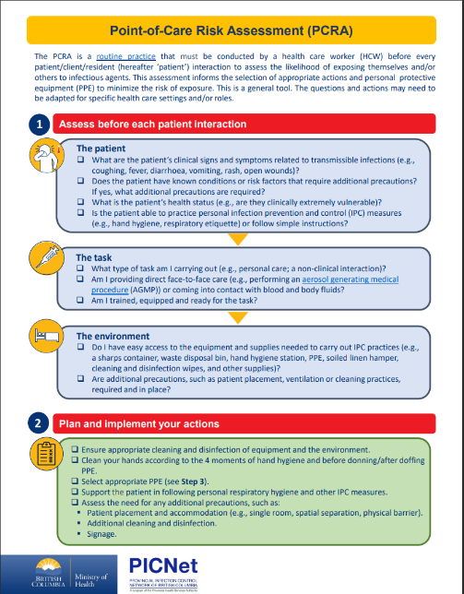
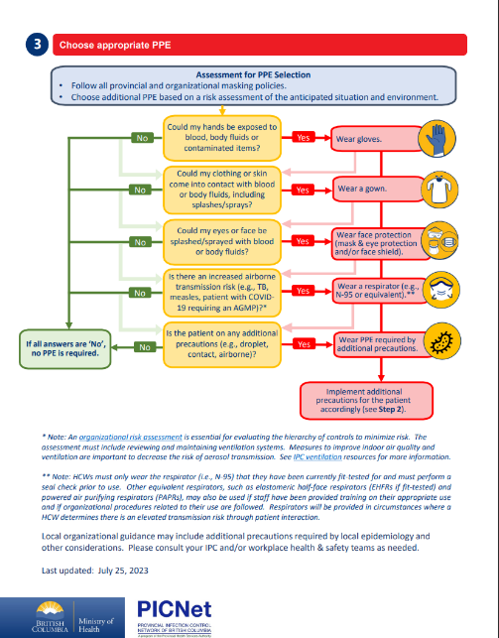
PCRA
ASSESS
PLAN
CHOOSE
Point Of Care Risk Assessment Tool - 2023 July 25 FINAL
Notes:
Point Of Care Risk Assessment Tool - 2023 July 25 FINAL
This is another tool that can help determine the supplies or the type of PPE needed for the task.

Slide 12
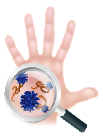
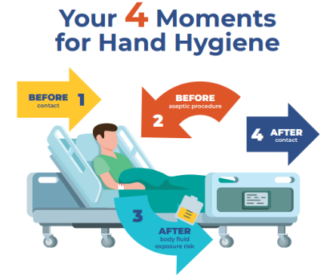
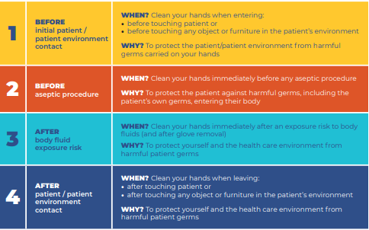
Hand Hygiene
Hand Hygiene
Hand Hygiene Guideline
Invisible Challenge II - Spread of bacteria in hospital settings
Notes:
healthbc.sharepoint.com/sites/IPCPortalIH/Shared Documents/Forms/All.aspx?id=%2Fsites%2FIPCPortalIH%2FShared Documents%2FHand Hygiene Guideline%2Epdf&parent=%2Fsites%2FIPCPortalIH%2FShared Documents
Explain:​
Hand hygiene is the single most important procedure for preventing the spread of HAI’s thereby reducing patient morbidity and mortality from HAI’s
HH is a shared responsibility between all site employees, patients and visitors, and is an organizational priority
At minimum HH will be followed using the 4 Moments for Hand Hygiene
Incorporate a HH return demo now or at the end of the presentation.
It is important to know the 4 moments of Hand Hygiene for Accreditation.
Hand hygiene must be performed:
Before
Contact with a patient or their environment.
Aseptic procedure. (not relevant for EVS)
After
3. Body fluid exposure risk.
4. Contact with a patient or their environment
Wearing gloves is not a substitute for performing Hand Hygiene. Hand Hygiene must be performed prior to donning gloves and after doffing gloves

Slide 13
Additional Opportunities for Hand Hygiene
On entering or exiting a unit
Between each step of removing PPE
Before accessing clean supplies or shared computers
Before and after eating or drinking
After using the washroom
After sneezing, coughing or using a tissue
Notes:
HH audits are attributed to the area where the audit is being done and quarterly reports are shared with managers.
The area that is being audited includes any healthcare worker is observed on the unit. The report can be broken down by discipline: nursing, physicians, EVS, allied health and so on.
Main areas and each unit is required to publicly display their facility’s quarterly hand hygiene report. This does not break it down by discipline, but rather the unit HH compliance rate.
The reports are also posted on SharePoint, Infection Control, Hand Hygiene.
Hand Hygiene Surveillance & Reporting

Slide 14
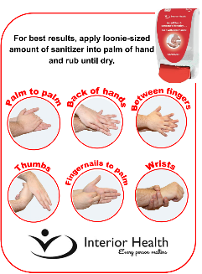
Alcohol Based Hand Rub (ABHR)
ABHR is the preferred method of Hand Hygiene when hands are not visibly soiled
1. Apply product liberally to palms of hands
2. Spread thoroughly over hands, including backs, thumbs, and wrists
3. Rub until dry (15 seconds)
Notes:
*Demonstration on how to do HH if not done on HH slide
-germs are killed during the drying process
Alcohol-Based Hand Rub (ABHR): is the preferred method to routinely decontaminate hands in clinical situations when hands are not visibly soiled as they provide for a rapid kill of most transient microorganisms
-less time consuming than washing with soap and water and are easier on skin.
-ABHR shall contain 70 - 90% alcohol.

Slide 15
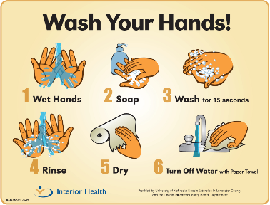
Soap and Water
Hand hygiene with soap water MUST be performed when hands are visibly soiled, or during Norovirus or Clostridioides difficile (CDI) Outbreaks.
1.Wet hands with warm running water
2. Apply soap
3. Lather hands for 15 seconds, scrubbing backs of hands, thumbs and wrists
4. Rinse well with warm running water
6. Use paper towel to turn off tap
5. Pat hands dry with paper towel
Notes:
If there is no Hand Washing sink in close proximity, clean hands with ABHR (hand sanitizer) and then wash with soap and water at first opportunity.
Use a dedicated Hand Washing sink if available.
Do not perform Hand Hygiene at a patients sink, as this may cause re-contamination of the employee’s hands.
The Hand Care Toolkit was developed to provide Interior Health staff with the tools they need to maintain healthy hands while ensuring proper hand hygiene techniques.
This toolkit has been created by Workplace Health and Safety (WHS), to be reflective of information provided by Infection Prevention and Control (IPAC), in an effort to prevent and manage skin problems that may be experienced by staff working in healthcare healthbc.sharepoint.com/sites/OcchealthPortalIH/Shared Documents/Forms/AllItems.aspx?id=/sites/OcchealthPortalIH/Shared Documents/Hand Care Toolkit.pdf&parent=/sites/OcchealthPortalIH/Shared Documents

Slide 16

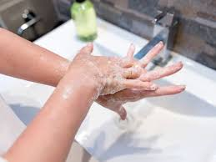
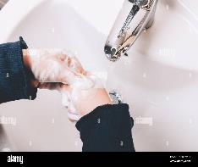
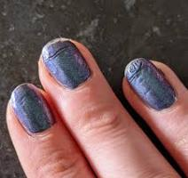
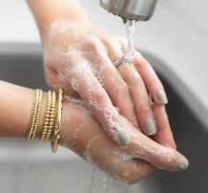

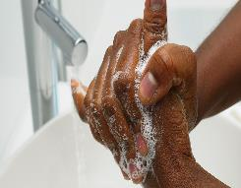
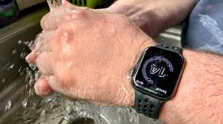

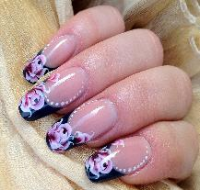

Nails, Jewelry and Clothing
1
2
3
4
5
8
9
10
6
7
Notes:
Let’s review these pictures and discuss why some are acceptable and why some are not.
IH has a hand hygiene policy that references the following:
Rings and hand/wrist adornments should not be worn by those having direct contact with patients or while performing Hand Hygiene. If the healthcare setting allows employees to wear adornments, it should be limited to a single smooth band without projections or mounted stones.
Nails must be kept clean, short and must not show past the end of the finger.
Nail polish, nail gel, artificial nails and nail enhancements must not be worn by employees who have direct contact with patients
Watches will be removed or pushed up above the wrist by employees who provide direct patient care before performing Hand Hygiene
Long sleeves must be pushed up to not interfere with Hand Hygiene
These examples show adornments that prevent effective hand hygiene and they can all harbour bacteria.
Goal – BARE BELOW THE ELBOWS!

Slide 17
Gloves
Wear non-sterile gloves when
In contact with blood or bodily fluids
Handling dirty or potentially contaminated items
Your hands have non-intact skin (open cuts, lesions or rashes)
Gloves are not a substitute for Hand Hygiene!
Perform hand hygiene before accessing and donning and immediately after doffing gloves
Notes:
Read top point: more examples on next slide
Gloves are single use – dispose of them immediately after use
Use gloves for the task they are required for, then dispose and perform HH
Do not walk from room to room or bed space to bed space and other areas of the health care facility wearing the same pair of gloves…..high risk CROSS CONTAMINATION
Do not wash or reuse disposable gloves.
Do not wash or sanitize gloves
Inappropriate glove use includes going room to room or bed space to bed space with same pair of gloves......spreads bugs!!
It is estimated that BC’s Health Care System uses 552 million gloves every year! (new PICNet HH day poster)
Adapted from the World Health Organization’s World Hand Hygiene Day 2025 Campaign; BC GreenCare, 2024; PHSA Procurement & Supply Chain, 2025

Slide 18
Glove use in EVS
In contact with blood or bodily fluids
The posted Additional Precautions sign indicates they are required
Cleaning an item or area contaminated with blood or bodily fluids
Handling garbage
Handling soiled linen
You have an open wound or non-intact skin
Wear a single pair of vinyl or nitrile medical exam gloves when
Notes:
Highlight re: handling garbage, or items that appear contaminated? When using cleaning product for extended time or if cleaning products indicates gloves are required?
healthbc.sharepoint.com/sites/EnvSvcsPortalIH/Shared Documents/Forms/AllItems.aspx?id=%2Fsites%2FEnvSvcsPortalIH%2FShared Documents%2FEVSSOP304 Glove Use in Environmental Services %281%29%2Epdf&parent=%2Fsites%2FEnvSvcsPortalIH%2FShared Documents

Slide 19
Gloves are NOT required when:
Handling clean items or supplies
Operating tools and equipment that would not have blood or bodily fluids on it (brooms, scrubbers)
Moving about the building
Making a clean bed
Notes:
Gloves are not needed to answer the phone, open doors, push elevator buttons, etc…
Have you seen examples in healthcare, or in public where you wondered why someone was wearing gloves?
TRUE or FALSE? Gloves protect your hands, therefor it is not necessary to perform HH after removing gloves
FALSE: hand hygiene must be performed before putting gloves on, and after removing them
-gloves can have micropores in them
-it is common to contaminate your hands during glove removal
-inside the gloves is warm, and can be a great place for organisms to live (if hands weren’t washed properly before putting gloves on, and if organisms did get through any micropores or holes in the gloves)
Who could remind us the 4 moments of HH?
Answer:
Before contact with pt or pt environment
Before aseptic/clean procedure
After contact with blood or bodily fluids
After contact with the patient or the patient environment

Slide 20
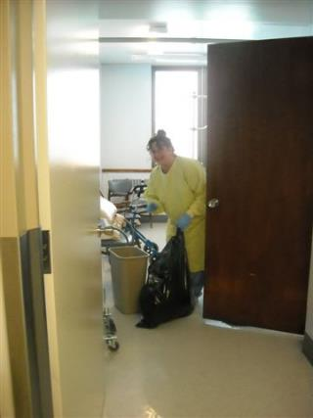
Single Bed-Room Clean
First: Clean bed space
Second: Clean bathroom
REMOVE Gloves and perform Hand Hygiene
Notes:
When emptying garbage, you never know what will spill out or break apart!

Slide 21
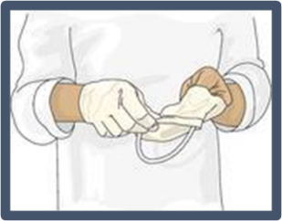
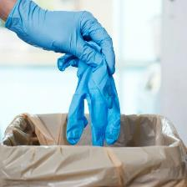
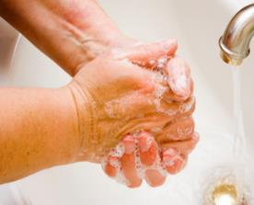
Multi-bed-room Clean and Disinfection
Hand Hygiene is done before and after cleaning of each bed space
Gloves are removed and Hand Hygiene is performed before cleaning the bathroom
REMOVE
TOSS
WASH
Notes:
Read slide

Slide 22
Gowns
Perform Hand Hygiene before donning and immediately after doffing gown
Tie gown at neck and waist
Do not wear gowns as a warm-up jacket
Do not re-use gowns
Worn during activities likely to generate splashes of blood, bodily fluids or chemicals
Additional Precaution sign is posted indicating gown should be worn
Notes:
Common observations we see:
-miss tying waist tie
-walking around unit with gown on (what message are we sending if wearing gowns in hallways, etc?)
-using gown because you are cold

Slide 23
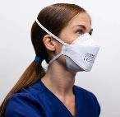
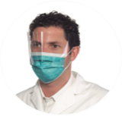


Face Protection (Masks and Eye Protection)
Perform Hand Hygiene before donning mask and eye protection
Prescription glasses are not sufficient to protect against splashes or droplet sprays
Perform Hand Hygiene after removing mask and eye protection
Clean and disinfect re-useable eye protection after each use
Wear facial protection to protect your mouth, nose and eyes as per PCRA (such as when there is risk of splashes)
Don mask and eye protection when the posted signage indicates it is required
Notes:
Germs (micro-organisms) can enter your body through your eyes, mouth and nose – this is why it is important to protect those portals of entry when there is a splash risk
Can you give examples of incorrect ways you have seen people wear a face mask?
-hanging off 1 ear
-under chin (chin cradle)
-tied and hanging off neck
-hanging off arm (used, not good either way)
-under the nose
Does the mask or eye protection cover the areas adequately, including a proper fit over prescription glasses? Make sure they stay in place when you are bending and completing your tasks
If you touch your mask – you need to wash your hands
Show samples
Show signs

Slide 24
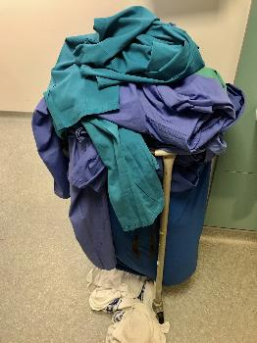
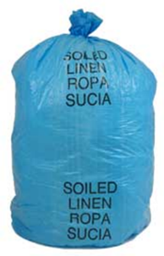
Laundry
Use gloves when handling soiled linen (add gown if needed)
Handle soiled/used linen with minimal agitation and place directly in linen bag without sorting
Double bag only if leaking
Do not overfill bags
Notes:
Remember, treat every item as if it is contaminated – wash your hands after handling – do not touch your face, eyes, etc until you have washed your hands!
No evidence that infections are spread by laundry or dishes if handled correctly (unless sharps present)

Slide 25
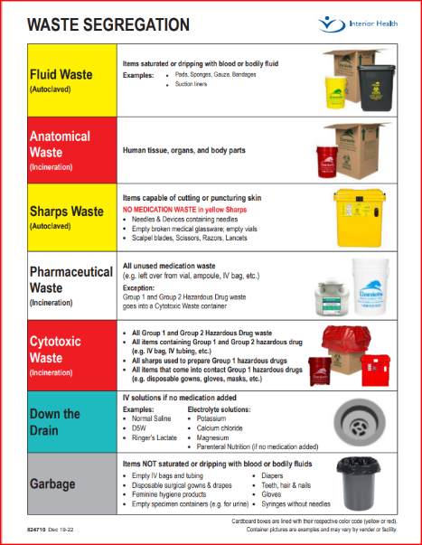
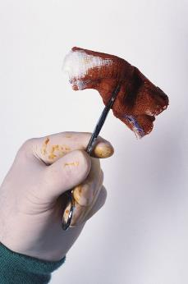


Waste Management
IPAC Recommendations for Waste Management
Notes:
Wear gloves to remove waste from patient rooms, treatment rooms or if the outside of the bag is soiled, followed by Hand hygiene after disposal.
Spare garbage bags should not be stored in bottom of waste receptacle (if main bag leaks, then the new bags under will be contaminated and will need to be thrown out)
Avoid contact with clothing/body.

Slide 26
Blood and Bodily Fluid Spills
Wear required PPE to clean up spills (gloves, gown, safety goggles and face shield if splash risk)
1
Clean the area: gross soil must be removed prior to cleaning and disinfecting.
2
Use paper towels for small spills, mop for large spills.
3
Used paper towels should be placed in biohazardous waste container
4
Mop heads should be placed in biohazardous waste container
5
Disinfect area with approved hospital disinfectant
6
Perform Hand Hygiene after task complete
7
CLEAN
DISINFECT
Implementing a Hazardous Substance Spill Response Plan
WorkSafeBC
Notes:
Read Slide
Links to Workplace Health and Safety for information on eye and face protection, link to OH WorkSafeBC

Slide 27
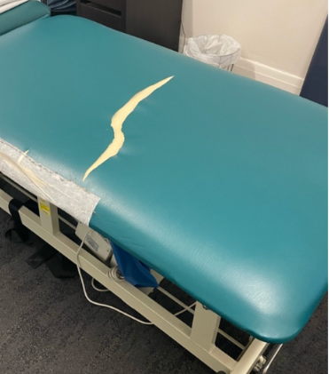
EVS & Routine Cleaning
Use designated floor cleaner. Do not double-dip cloths or mops into the cleaning solution
Do not “top up” liquid soaps or alcohol hand rubs
Report broken, torn, cracked items/equipment
High touch surfaces require daily cleaning
Enhanced cleaning required during alerts and outbreaks
Notes:
Read slide
HIGH touch – next slide gives examples

Slide 28
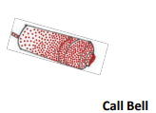


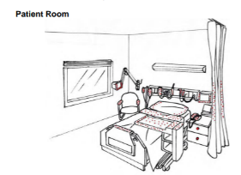
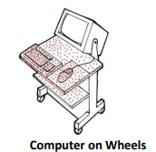
What are High Touch Surfaces?
Overbed tables
Doorknobs
Toilet seats
Examination tables
Telephones/computers
These objects can be a source of transmitting organisms if they are contaminated, touched and hand hygiene is not done
Notes:
These objects may appear clean, but are actually high risk items that can get onto employees and patients hands.
This about how many people enter a patient’s room in a day, and how often these items get touched

Slide 29
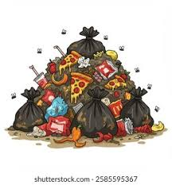
Step 1 CLEAN
Clean to remove any foreign matter from the surface or equipment using friction
Clean from cleanest area to dirtiest area (i.e. patient room to bathroom, top to bottom)
Use as many cloths as needed until it comes away clean
Proceed to Step 2 Disinfect
Avoid contaminating already clean surfaces
Notes:
It is impossible to disinfect a pile of dirt – Must remove the “stuff” and clean, prior to step 2

Slide 30
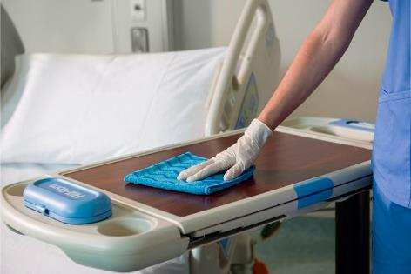
Step 2 DISINFECT
Use fresh cloth to disinfect again using a friction (rub/scrub) motion
Allow surfaces to remain wet for the necessary ‘contact time’ followed by air-drying as written on the product label
Attach "I am Clean" or "Green is Clean" sticker to the clean equipment and store in dedicated clean storage area
IPAC Equipment Cleaning and Disinfecting Manual
Notes:
Disinfection cannot occur without effective cleaning of visible debris

Slide 31
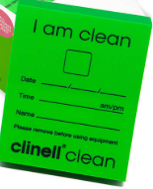
Reusable Patient Equipment
Clean and disinfect reusable equipment after use, when visibly soiled and before use on another patient.
Clean visible soil, then wipe all surfaces with disinfectant and let dry.
green tape indicates item is clean
Notes:
Some units have a system for labeling their clean equipment, learn the system and use it to identify clean equipment.
Reusable equipment from isolation rooms can be taken to soiled utility room for cleaning and disinfection
Stress when taping an item that it needs to impact the use of the piece of equipment: clean equipment should be stored in a designated clean area
Remember to remove the green is clean sticker once the item is in use!

Slide 32
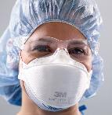
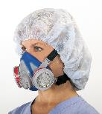
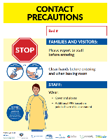
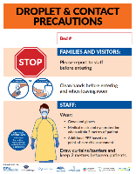
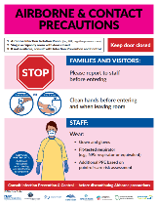
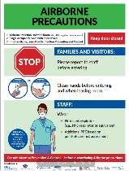
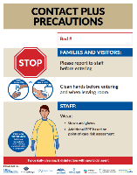
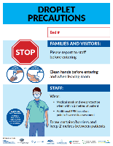
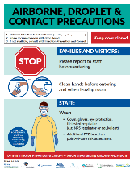
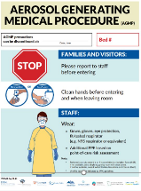
Additional Precautions
Common Precautions: Don PPE as indicated
Airborne Precautions: Don PPE as indicated
MUST be fit-tested for N95 (update yearly)
Infection Control (bccdc.ca)
Notes:
Recently updated Provincial Additional Precautions signs.
With each sign there is a guideline available for proper usage – show the section on the IPAC sharepoint site. Additional Precautions
Remember if you have not been fit tested you cannot go into any rooms that have an Airborne precautions sign.
Once the patient is discharged:
Negative pressure room requires 45 minutes air clearance time before you can enter without an N95
Regular patient room requires 2 hours air clearance time.
When a HCP is working with patients on droplet or droplet contact precautions and an AGMP procedure is in place, then AGMP guidelines are followed from Infection Control (bccdc.ca) and an N95 mask must be donned.

Slide 33
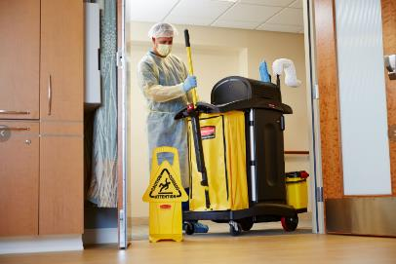
Additional Precautions (AP)
Discharge Clean
Perform the AP room cleaning procedures
When patient is discharged
Transfer or death of a patient on Additional Precautions
When Additional Precautions are discontinued
Perform Hand Hygiene and don PPE as indicated on AP sign
Notes:
Follow the instructions on the signs posted on doorways to patient rooms
Some signs are posted in Long Term Care during outbreaks and with residents with CDI
Personal protective equipment (PPE) will be used based on point of care risk assessments with each patient/resident interaction

Slide 34
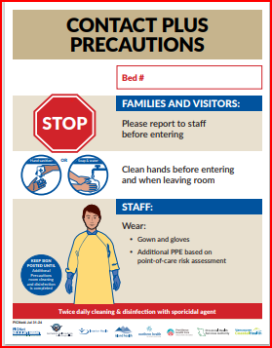


Contact Plus Additional Precautions Clean and Disinfection
How many hours must lapse between the 1st and 2nd clean?
Notes:
Tell me what this sign tells you?
2x a day cleaning
Disinfectant is changed to a sporicidal
Perform Hand Hygiene
Don proper PPE as indicated on the AP signage
Clean all horizontal and highly touched surfaces at least twice daily or more frequently as requested by nursing.
How does your site document contact plus cleans? Some sites may have different processes.
Answer to question on slide: Perform the second clean 6-8 hours after the first clean
Cautious not to use “c-diff”, as we are now using this for CPO as well.****
-there may be times when this sign has been removed by nursing without an isolation clean: this sign is used for some screening tests, and in those situations – if the tests are negative, the sign can be removed by nursing without any additional cleaning
-if you have questions, you can always ask the nurses or the charge nurse

Slide 35

Where to Remove PPE from AP Cleans
Remove PPE from the neck down within the room
Remove mask and eyewear outside of the room (if unable to have 2 metre distance from patient)
For Airborne or AGMP precautions: remove N95 OUTSIDE the patient room
Notes:
AIIR/Anterooms/Airborne Precautions/AGMP
If an anteroom is available with the Airborne Isolation Rooms, it is considered a “clean area”.
PPE is put on in the anteroom.
All PPE EXCEPT N95 or respirator are removed inside the PATIENT ROOM.
The N95/respirator is removed in the ante room after patient’s room door has been closed. Hand hygiene is to be done in the anteroom prior to leaving it.
If no Ante-room, remove N95/respirator in hallway after patient’s room door has been closed. Perform Hand hygiene after removing N95/respirator.

Slide 36


Donning of PPE video
Doffing of PPE video
Notes:
Donning and Doffing PPE posters​
!Remind staff to ensure performing HH after each step of doffing PPE!
Do a return demo with staff in person or over teams.
Could share donning and doffing videos if unable to do in person or on teams:
Donning of PPE video
Doffing of PPE video
​

Slide 37



IPAC Home Page
https://healthbc.sharepoint.com/Sites/EnvSvcsPortalIH
Notes:
Explain:​
The infection control manual is found on the InsideNet​
To reach an Infection Preventionist- vocera, call local or cell. Contact info located on IPAC home page.​
​
Educator Task:​
CLICK THE PIC to show infection prevention and control resources on the live site​
Navigate the site show where the different resources are applicable to EVS, Additional Precautions Resources, signs, Routine practices, HH, Cleaning and Disinfection
Show where there are resources for staff – TOOLS
Move over to the IPAC Resources – and the Manual Section 04H – Additional Precautions can show the signs
Show the Hand hygiene policy and where the hand Hygiene audit rates are

Slide 38

Environmental Service Workers are an Integral Part of the Care Team
To achieve an acceptable standard of cleanliness there must be a culture that cleanliness matters at all levels of the organization
We are ALL responsible for
Infection Prevention & Control
Notes:
Housekeeping is an ‘essential’ service
-you are an integral part of the team to assist a person through their health-care journey

Slide 39
Thank you!
Notes:
Do you know who the infection control practitioner is for your site?

