Slide 1
Volunteer Onboarding
Infection Prevention & Control
For more information contact IPAC@interiorhealth.ca
July 2024
Notes:
Welcome to Interior Health Volunteer Program!
Infection Prevention & Control (IPAC) is important for keeping yourself and patients safe.
We are going to review IPAC essentials you need to know for your volunteer experience!

Slide 2
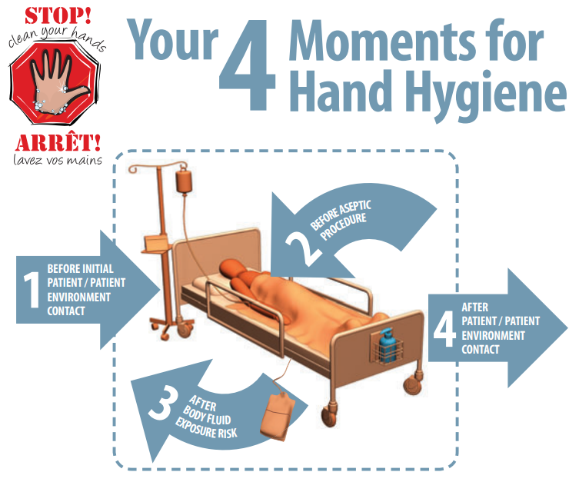
Hand Hygiene
Notes:
Hand hygiene refers to removing or killing microorganisms (germs) on the hands.
Washing your hands not only prevents you from getting sick, it reduces the risk of infecting others.
If you don't wash your hands properly before coming into contact with others, you can infect them with the germs on your hands. Other people can also get sick from the germs that unwashed hands leave on shared objects such as doorknobs, keyboards and other equipment in the home or workplace.
Interior Health utilizes the “4 moments” for hand hygiene.
The moments that apply to volunteers are
Before contact with patients or their environment (which includes curtains)
4. After contact with patients or their environment.
Volunteers are encouraged to remind patients to perform hand hygiene. Individual hand sanitizers are available for patients – just ask nursing staff

Slide 3
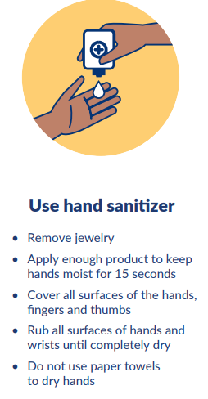
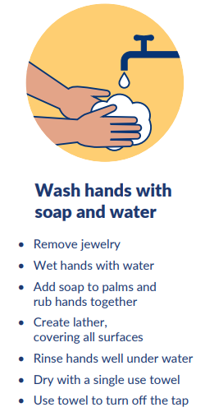
Alcohol Based Hand RUB ( ABHR)
VS
Soap and Water
Notes:
Hand hygiene can be done using Alcohol Based Hand Run (ABHR/hand sanitizer) or soap and water.
ABHR is the preferred method of hand hygiene as it kills germs on contact and is easily available.
Soap and water removes dirt and should be used over ABHR when hands are visibly soiled .
ABHR ( hand sanitizer)
When using ABHR ensure your hands are not visibly soiled
Remove Jewelry
Apply enough product to keep hands moist for 15 seconds
Cover all surfaces of the hands, fingers, and thumbs
Rub all surfaces of hands and wrists until completely dry
Do not use paper towels to dry hands
2. Soap & Water
Remove Jewelry
Wet hands with water
Add soap to palms and rub hands together
Create a lather covering all surfaces
Rinse hands well under the water
Dry with a single use towel
Use towel to turn off tap
ABHR is the preferred method of hand hygiene

Slide 4
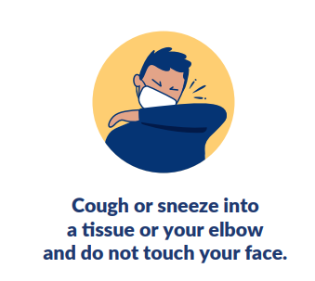
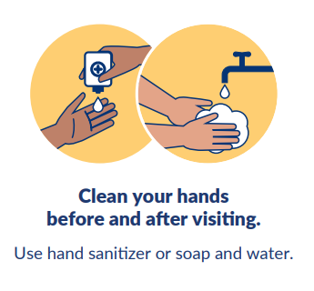
Respiratory Etiquette
  Tissues are single use, don’t keep them tucked up your sleeve.
  Stay home if feeling unwell, and do not return until your symptoms resolve
Perform hand hygiene
After coughing
or sneezing
Notes:
Cover your mouth with your upper sleeve or elbow when you cough or sneeze, or use a tissue.
Tissues are single use, don’t keep them tucked up your sleeve.
Perform hand hygiene after coughing or sneezing.
Stay home if feeling unwell, and do not return until your symptoms resolve

Slide 5
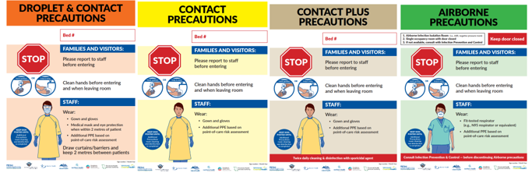
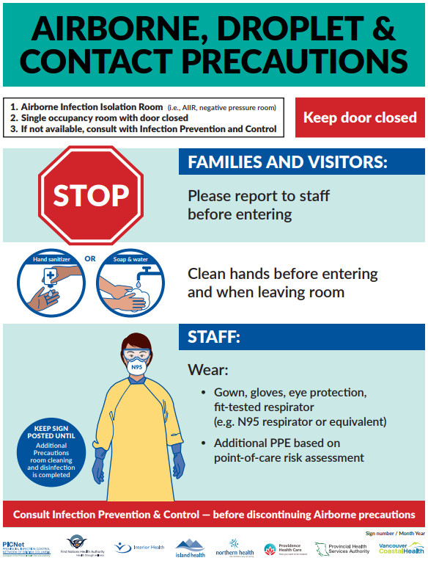
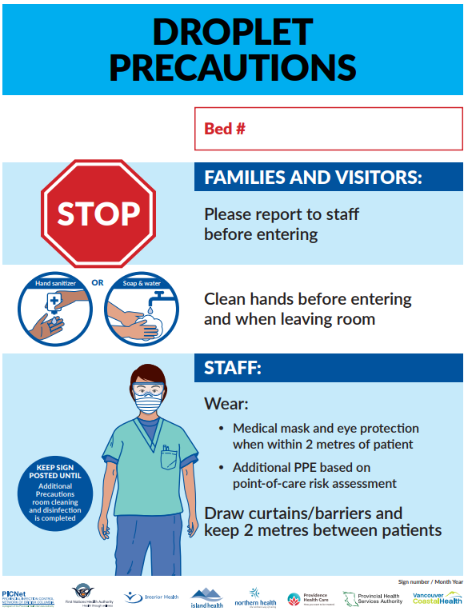
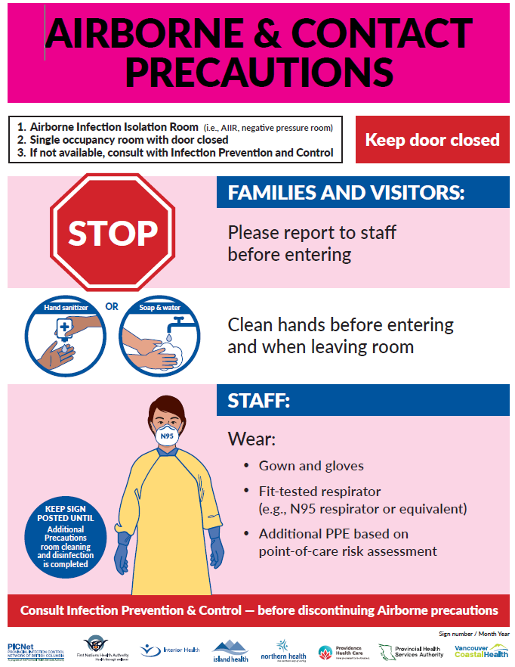
Additional Precaution Signs
Notes:
Watch for signage outside of patient rooms, or on their curtain.
What are additional precautions signs ?
Additional precautions signs communicate to healthcare providers and visitors that specific precautions must be taken before entering the patient's room to prevent the spread of infectious disease
Note the colorful isolation signs used in interior health.

Slide 6

What do Additional Precaution signs mean for volunteers?
DO NOT ENTER
Notes:
DO NOT ENTER THE ROOM,.
Volunteers should not enter rooms with signage that indicates patients are on Additional Precautions.
If a facility is experiencing an outbreak, volunteer services will be temporarily stopped until the outbreak is over (a sign will be posted at the main entrance of the facility).

Slide 7
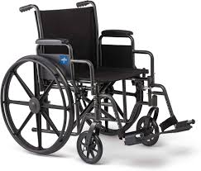
Cleaning and Disinfection
How do I Clean & Disinfect Equipment?
Cleaning and Disinfecting is a two-step process:
1) CLEAN: Use wipe(s) to clean off any dirt or debris,
2) DISINFECT: then use new wipe(s) to disinfect equipment.
Use friction , and allow for contact time with cleaning solution, and let it dry !
Who is Responsible to Clean & Disinfect Equipment?
It is a shared responsibility between all healthcare providers and departments !
When is Cleaning & Disinfection Required ?
Clean & Disinfect equipment immediately after use or contact with a patient:
  Wheelchairs, mobility equipment
  Phones, pens, computer equipment
Notes:
Cleaning and disinfection: Use disinfectant wipes to clean and disinfect items like pens, cell-phones, wheelchairs, or things that have come into contact with the patient or their environment.
Cleaning and disinfection is a 2 step process:
Step 1: Clean – Clean to remove any foreign matter from the object using friction (rub/scrub motion). Use as many wipes as needed until wipe comes away clean.
Step 2: Disinfect – use fresh disinfectant wipe to disinfect again using a friction (rub/scrub) motion. Allow surface to remain wet for the necessary "contact time" followed by air- drying as written on the product label.
Gloves- not a substitute for hand washing. Always clean your hands before and after use

Slide 8
Cleaning & Disinfection
How do I know something has been cleaned and disinfected?
Think " Green is Clean"
Most units use green tape or sticky green notes on equipment to let everyone know it has been cleaned and disinfected
It is stored in a clean room or area (not dirty service)
If you are unsure of whether an item has been cleaned, clean and disinfect it before use.
Be aware of the product you are using and safety information.
If gloves are used, hands must be cleaned before and after use.
Notes:
. Many units use the motto “green is clean” to help differentiate which equipment is clean & disinfected and ready for use. After cleaning, disinfecting, and storing equipment, use green tape or a green sticky to communicate that it is safe to use on another patient or place in a dedicated labelled clean zone

Slide 9
Thank-you

