Slide 1


Get Schooled on Radon:
The Silent Intruder in Our Classrooms!
Colin Dumais
Radon West Ltd.
November 20 and 27 2023

Slide 2


About Me
Canadian National Radon Training Centre/Radon West Ltd.
Trainer approved by the Canadian National Radon Proficiency Program (C-NRPP)
Radon professional that has tested and fixed schools
Mad about building science!
©Radon West Ltd.

Slide 3

  BC Data

Slide 4
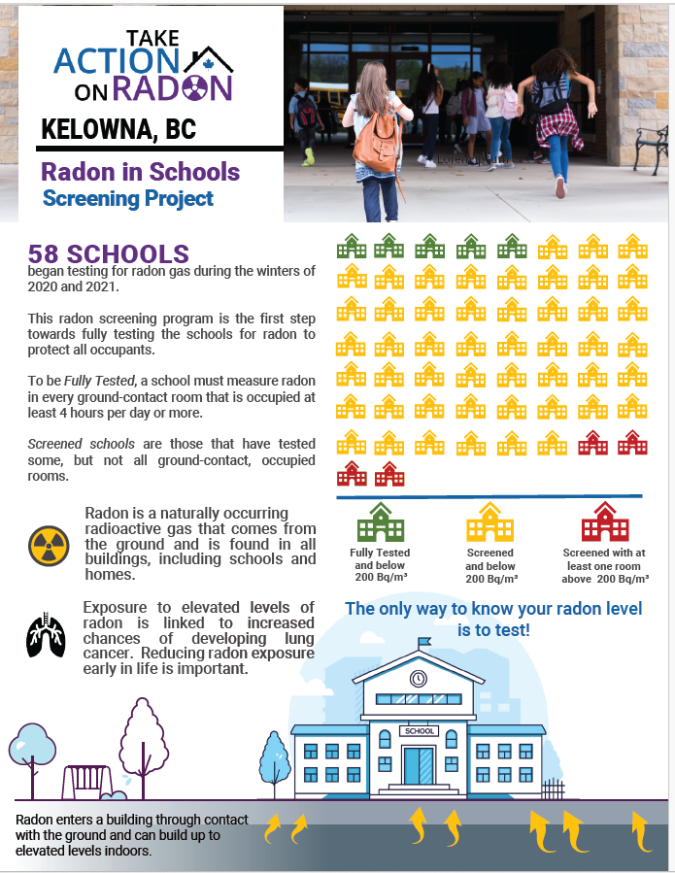

Slide 5

How Do We Know If There Are High Levels Of Radon?
Her big brown eyes can’t see it
Her freckled nose can’t smell it
Her giggling mouth can’t taste it
You only know if you test for it
©Radon West Ltd.

Slide 6

There Is A Right Way To Test
A+
©Radon West Ltd.

Slide 7

And A Wrong Way To Test
Fail
©Radon West Ltd.

Slide 8

Length Of Time
Radon levels fluctuate based on a multitude of factors
A minimum of a 91 day test
Averages out the peaks and valleys
Short term testing has risks of false
negatives and false positives
We want to see the movie, not
just the commercial
©Radon West Ltd.

Slide 9
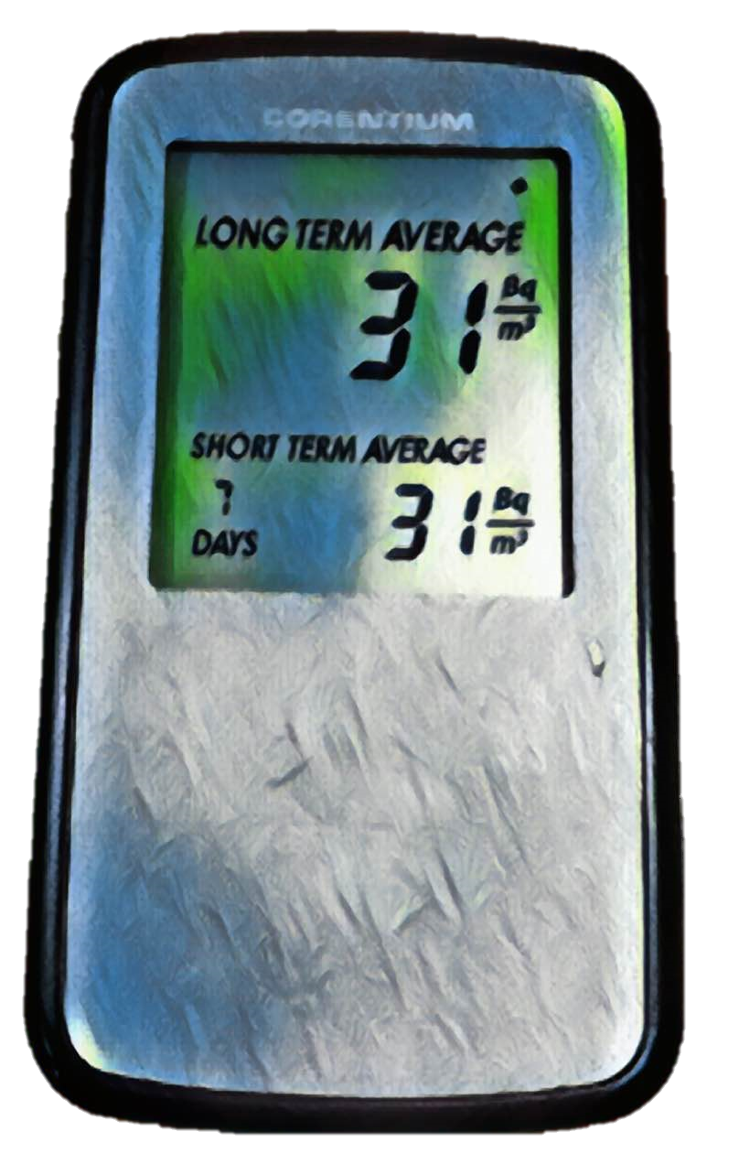

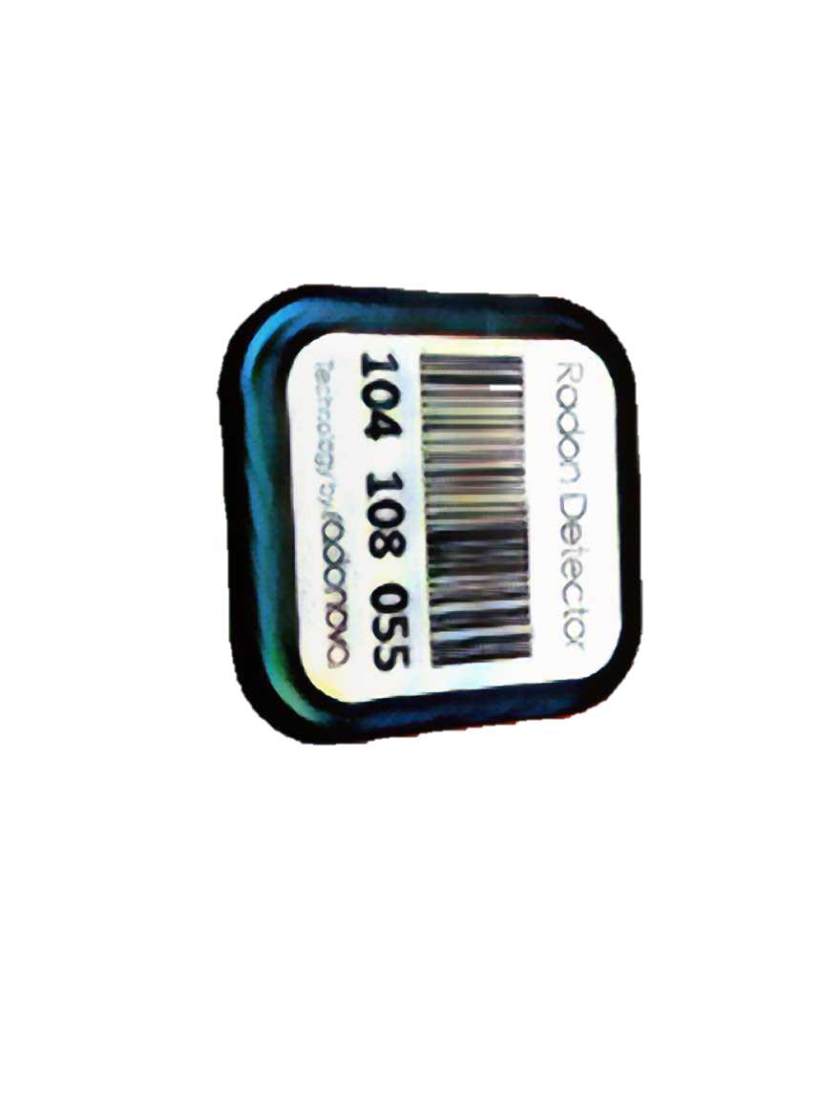
Device Types
Long-term alpha track tester
C-NRPP listed devices
https://c-nrpp.ca/approved-radon-measurement-devices/
A+
Consumer-grade
electronic device
©Radon West Ltd.

Slide 10

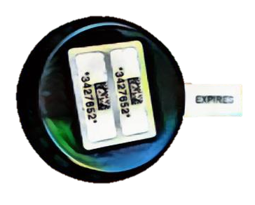
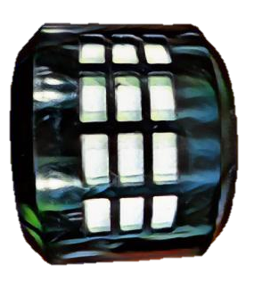
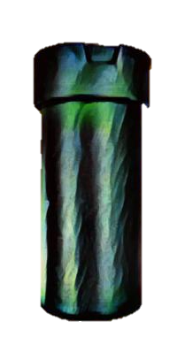
Long-Term Test
A+
Reliable and accurate
Inexpensive
Analyzed by independent lab
Ideal for long term testing
Indestructible and non-toxic
Gold standard
Holds up in court!
©Radon West Ltd.

Slide 11
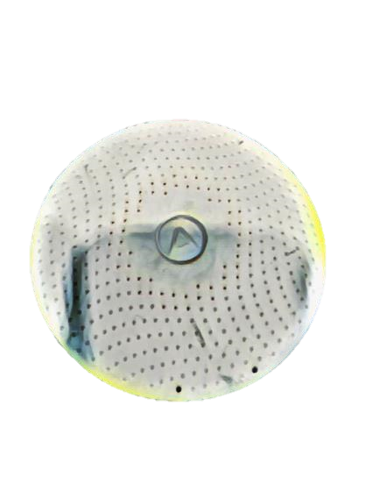
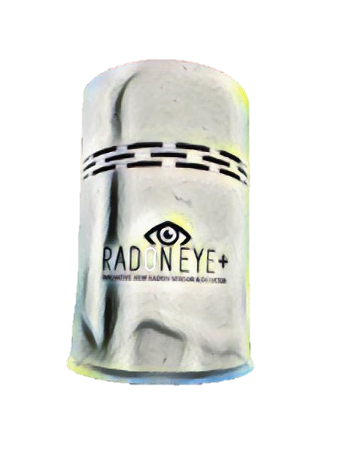
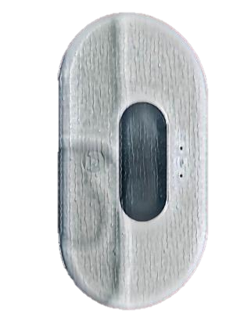
Consumer Grade Electronic Monitors
Convenient
Easy and fun
Readings displayed on device
Ideal for investigating
Screening
©Radon West Ltd.

Slide 12

The Right Location
A+
Lowest level rooms of the building that that is occupied at least 4 hours/day
Breathing zone (0.5 - 2m/1.5 - 6.5ft above floor)
Away from exterior walls
Place on a flat surface like a desk,table or shelf
Or hang from the ceiling or on an interior wall
Keep in mind words that often describe kids include “curious” and “mischievous”!
©Radon West Ltd.

Slide 13
The Wrong Location
Fail
In a kitchen, bathroom, mechanical room, closet, or unfinished areas
On an exterior wall
On or near air vents
On or near exterior windows or doors (drafts)
On or near heat sources
On or near electronics
©Radon West Ltd.

Slide 14

How Many Devices
Usually just one per room but large rooms may need more
Additional detectors for rooms >200 m² (2153 ft²) area
Example - large rooms such as gyms and learning commons
  201 m² requires 2 detectors
  401 m² requires 3 detectors
©Radon West Ltd.

Slide 15
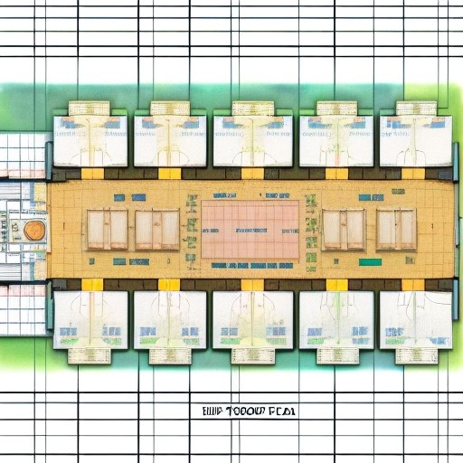
Which Rooms?
All lowest level rooms with occupancy of 4 hours or more per day
Portables
©Radon West Ltd.

Slide 16

Quality Control And Assurance
Very specific processes
Accredited labs
Increase confidence in results
Helps validate recommendations
Check for
  Precision – duplicates
  Bias – blanks
  Accuracy – spikes
©Radon West Ltd.

Slide 17
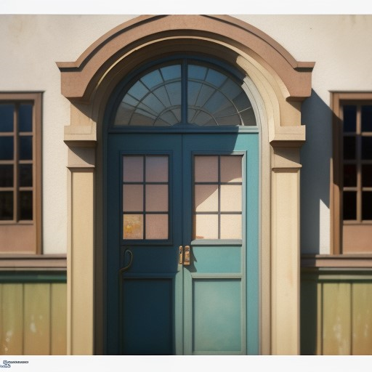
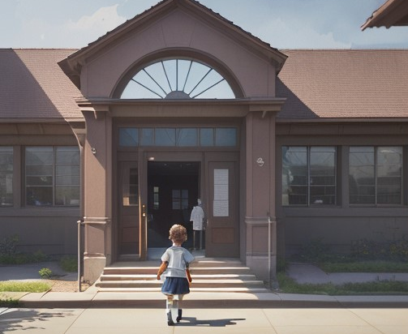
Protocols Specific To Schools
If the results of the long term testing show elevated radon then follow up with hourly testing with a Continuous Radon Monitor
This follow up testing separates the occupied hours from the unoccupied hours to determine if the levels are elevated when the building is occupied
Closed
Open
©Radon West Ltd.

Slide 18


A Few Resources To Help Out
https://www.interiorhealth.ca/health-and-wellness/environmental-health-and-hazards/radon-gas
https://takeactiononradon.ca/resources/school-resources/
https://www.carexcanada.ca/radon_in_schools/
And don’t forget the radon champions at BC Interior Health - Greg and Daniel
Greg here. My contact information is
Greg.Baytalan@interiorhealth.ca
(250) 469-7070 ext. 12273
I’m Daniel and I can be reached at
Daniel.Tse@interiorhealth.ca
(250) 469-7070 ext. 13800
©Radon West Ltd.

Slide 19


Learning Options For You
Option #1
  3 hour webinar introductory course
Option #2
  C-NRPP certification course
  FREE courtesy of Interior Health ($430 value)
  Limited seats available
©Radon West Ltd.

Slide 20
Which One Interests You?
Let Greg or Daniel at Interior Health know which course option you want to pursue
Courses scheduled based on interest
And mine is
Daniel.Tse@interiorhealth.ca
(250) 469-7070 ext. 13800
In case you missed it my contact information is
Greg.Baytalan@interiorhealth.ca
(250) 469-7070 ext. 12273
©Radon West Ltd.

Slide 21

The Consequences Of Not Testing
  Blindsided when “passionate” parents become vocal in media
  Now the response is reactive, not proactive
  Lose control of the conversation
  Due diligence
  Liability?
  And don’t forget about lung cancer
What do you mean you knew about radon years ago but didn’t test my little Timmy’s classroom?
©Radon West Ltd.

Slide 22

Tested High?
No need to pack up and run away
It’s fixable
©Radon West Ltd.

Slide 23

Now That You Have Your Feet Wet
  Make sure you connect with Greg or Daniel and choose the next step in your radon learning adventure
  A 3 hour webinar or C-NRPP measurement certification?
©Radon West Ltd.

Slide 24

What? A Contest And Prizes!
  Get kids interested with the BC Lung Association/Interior Health
    Student Radon Skill Testing Contest
  First prize: Beats Solo3 Wireless On-Ear Headphones
  Contest closes January 31, 2024
  Open to any students in Interior Health, from Grades 4 to 12
  A downloadable package for teachers, school administrators and staff
  More info at https://bclung.ca/radoncontest
©Radon West Ltd.

Slide 25

Thank You!
Questions?
Wishing You Low Levels Of Radon!
colin@radonwest.com
©Radon West Ltd.

