Slide 1
Acute Care Outbreak Toolkit
Infection Prevention and Control
August 2024
For more information contact IPAC@interiorhealth.ca

Slide 2
Land Acknowledgement
Interior Health would like to recognize and acknowledge the traditional, ancestral, and unceded territories of the Dãkelh Dené, Ktunaxa, Nlaka’pamux, Secwépemc, St’át’imc, Syilx, and Tŝilhqot’in Nations where we live, learn, collaborate and work together.

Slide 3
Acute Care Outbreak Guidelines Overview
The Acute Care Outbreak documents have been updated; Respiratory Illness (RI) and Gastrointestinal Illness (GI) guidelines amalgamated into one toolkit covering:
Prevention
Alert/Enhanced Monitoring and Surveillance
Outbreak
Notes:
The Acute Care Outbreaks toolkit has been updated and RI and GI guidelines amalgamated into one toolkit
The toolkit has also been prepared with all documents in one location that you can easily access that include the guideline, educational documents, Job Aids and documents specific to Outbreak management
We want to move away from ‘binders’ and advise staff to refer to online. If they chose to print off, remind them to check the online resources- IPs will not be printing off and providing.
The MHO’s directed that they wanted the LTC Outbreak toolkit updated as they are leading the OBs in LTC, this was updated in October 2023
The MM are delegated to lead the OBs in Acute Care.

Slide 4
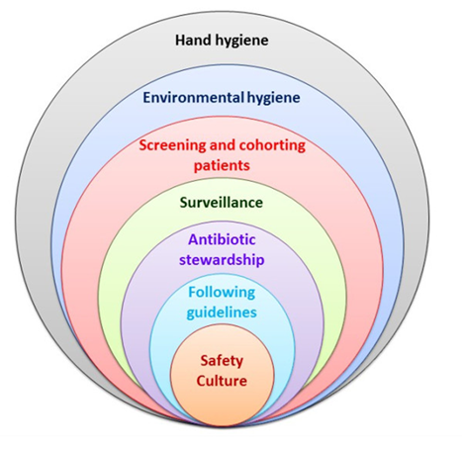
Prevention
Routine Practices
  Point of Care Risk Assessment
  Hand Hygiene
  PPE
  Respiratory Hygiene
  Cleaning and Disinfection
  Current vaccinations(as applicable)
Notes:
OUR GOAL IS TO PREVENT OUTBREAKS Strictly adhering to the basics of infection prevention in our everyday work:
While this work is required everyday, it is even more important that these measures are followed when RI or GI cases are identified on a unit.
IPs can reinforce these practices by demonstrating thoroughness of HH using Glo Germ in an interactive and fun way, IPs can also assess correct use of PPE by reinforcing the importance of PCRA, giving demonstrations of the correct donning and doffing procedures, having return demonstrations by staff with feedback from IPs. IPs can direct unit leaders to the PPE audit tool available on the inside net
IPs can also support an environmental audit of a unit prior to as well as during an OB to identify areas for improvement and collaborate with the unit manager to create an action plan for the improvements so progress is monitored and changes sustained- utilising the OB prevention audit tool
Additional Precautions HCS are familiar with Contact
Droplet
Airborne
Incorporating these practices into our everyday work will enable us to reduce the risk of outbreaks and/or the duration of outbreaks
Ensure Hand Hygiene leaflets and Hand Sanitizer are available
Enhanced Cleaning & Disinfection
Patients on Contact Plus, Contact and Droplet precautions should receive daily baths and linen and clothing change
For RI:
Offer Influenza& COVID-19 immunization to all unimmunized patients during the respiratory season

Slide 5
Acute Care Outbreak Toolkit 2024/2025
Prevention: Adhering to the basics of infection prevention by all healthcare providers in all environments always reduces the risk of spreading infections
Alert/Enhanced Monitoring & Surveillance: Early recognition and actions taken when RI/GI symptoms are observed reduces the risk of spreading the infection to other patients
RI & GI Outbreak Management: Based on situational assessments and risk that more restrictive measures are required, the decision to declare an outbreak will be made by the Medical Microbiologist, Infection Preventionist and Outbreak Management Team
Notes:
Discussion- move to Alert rather than Enhanced Monitoring & Surveillance
Case> Alert>Outbreak. Not always linear.

Slide 6
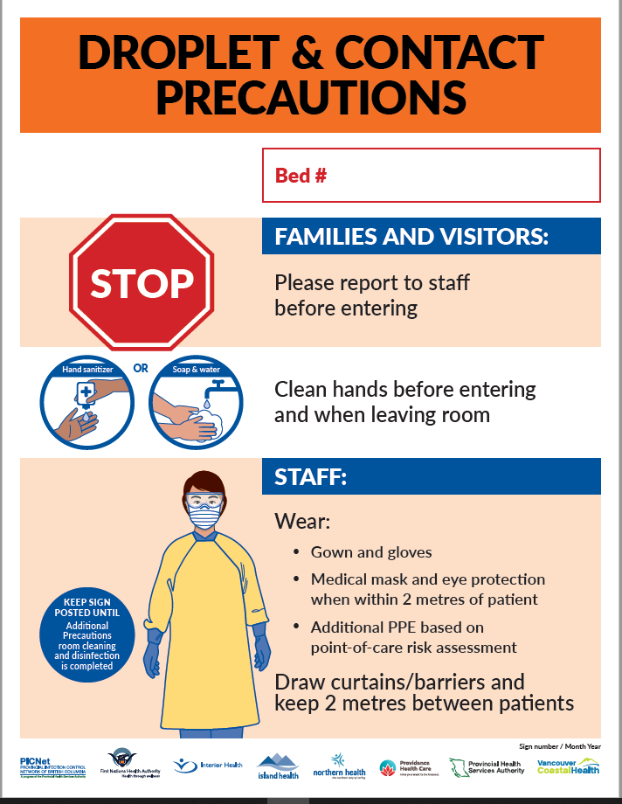
Cohorting
While a single room is preferred, they are not often available, for patients in multi-bedrooms, bedside isolation includes:
Drawing the curtains around the bed
Placing Additional Precaution signs on the curtain and room door
Dedicating a commode/medical equipment to the patient
Patient wears a medical mask - if tolerated
Notes:
No RI or GI suspect or confirmed cases are appropriate for corridors/hallways placement
Do we want to mention: Patients on AGMP with suspected RI or confirmed COVID diagnosis are generally not appropriate for cohorting
Talk about cohorting to support IPS with these discussions.
Infection Prevention & Control [IH] - IPAC Cohorting Recommendations.pdf (sharepoint.com)

Slide 7
Case Definition RI
A patient with a laboratory confirmation of infection with the virus that causes RI, (i.e., influenza, SARS- CoV-2, parainfluenza viruses, RSV, adenovirus, rhinovirus, human metapneumovirus) by validated laboratory testing AND signs and symptoms of acute respiratory infection.
ACTIONS for frontline staff:
Place on Droplet and Contact Precautions, test and report
Notes:
Emphasize the importance of staff understanding these signs and symptoms – this includes all staff such as allied health professionals, EVS who are in contact with patients but may not think they should be telling the nursing staff.
Loss of sense of smell or taste
Symptoms (bccdc.ca)ADD LINK TO BCCDC S&S – show ICPS the pages.

Slide 8
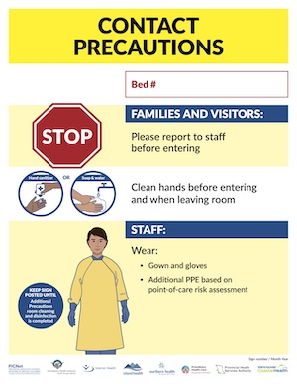
Case Definition GI
A case of probable GI infection is defined as any one of the following conditions that cannot be attributed to another cause (e.g. laxative use, medication side effect, diet, prior medical condition):
Two or more episodes of diarrhea in a 24-hour period – above what is considered normal for that individual, OR
Two or more episodes of vomiting in a 24-hour period, OR
One episode each of vomiting and diarrhea in a 24-hour period, OR
Positive culture for a known enteric pathogen with a symptom of GI infection (e.g., vomiting, abdominal pain, diarrhea), OR
One episode of bloody diarrhea
ACTIONS for frontline staff:
Place on Contact Plus Precautions - add Droplet if pt. is vomiting.
Notes:
Emphasize the importance of staff understanding these signs and symptoms – this includes all staff such as allied health professionals, housekeepers who are in contact with patients but may not think they should be telling the nursing staff.
If C-Dif a concern, then utilize Contact Plus Precautions and signage.
Symptoms (bccdc.ca)ADD LINK TO BCCDC S&S – sh

Slide 9
ALERT with Enhanced Measures
The purpose of implementing Alert with Enhanced Measures is to:
Reduce impact and duration
Prevent further spread and reoccurrence
Activate close collaboration between unit staff/leadership and IPAC to monitor situation and assess effectiveness of preventative measures
Notes:
Recognize that not everyone understands the rationale of implementing this Enhanced measure prior to outbreak. Emphasize the negative outcomes when the more restrictive measures are implemented for long periods of time on both patients’ physical and mental well-being.
IPs can use prepared scenarios to hold huddles on the unit with various level of staff for recognizing the probable signs of GI/RI and the actions they need to take
The objective of Alert/ Enhanced Monitoring is to separate infectious patients from non-infectious patients to prevent transmission
Close collaboration between unit staff/leadership and IPAC is important to monitor the situation on the unit, assess the safety measures in place and prevent the spread of a HAI
The Medical Microbiologist will assign case thresholds which are decision points to assess the effectiveness of the safety measures in place and the curtailment of transmission

Slide 10
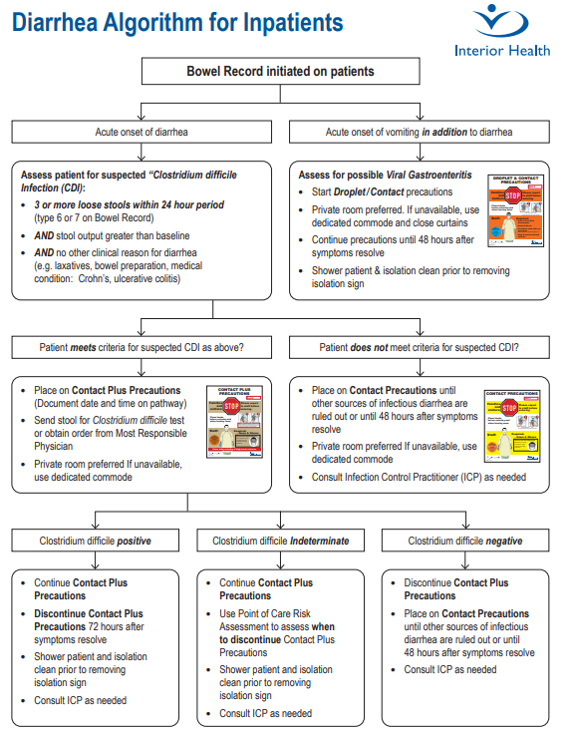
Patients presenting with Diarrhea:
Place on Contact Plus Precautions (add Droplet if vomiting)
Utilise Diarrhea Algorithm: 826690.pdf
Contact IPAC as needed

Slide 11
RI Alert Definitions
GI
Definition of Acute RI Alert Level:
COVID-19 and other RI’s (e.g. Rhinovirus) Alerts
2 Healthcare associated RI cases within the incubation period for that organism which are NOT directly explained by a contained exposure event AND
Cases have been identified in ≤2 patients’ rooms on the unit OR
IP investigation notes a high prevalence of RI
Influenza Alerts
2 Healthcare associated RI cases within the incubation period for that organism which are NOT directly explained by a contained exposure event OR
IP investigation notes a high prevalence of RI
Notes:
HAI's refers to an infection originating in a medical facility – the infection wasn't present or incubating at the time of admission
This also includes patients discharged from a healthcare facility with symptoms appearing after discharge within the incubation timeframe

Slide 12
GI Alert Definition
1 or 2 symptomatic Gastrointestinal Illnesses and/or laboratory confirmed cases of GI illness (HAI with symptomatic onset within 4-day period and no outbreak declared)

Slide 13
Laboratory Sample Collection
Symptomatic/Isolated Patient
GI : Obtain a stool or emesis specimen in a dry C&S container from each new symptomatic case
RI: Obtain Nasopharyngeal viral PCR swab which tests for COVID-19, Influenza A&B and RSV, +/- Magpix
Notes:
IH Microbiology sample collection container guide
IH Laboratory Ordering Instructions for C. Difficile and Infectious Diarrhea Panel Molecular Testing- Inpatient Wards and LTC

Slide 14
RI & GI Alert Measures:
Maintain strict adherence to routine practices and Additional precautions; such as, hand hygiene, cleaning and disinfection, and Point of Care Risk Assessment
Begin twice daily screening for RI signs and symptoms of patients on the unit for early case detection, isolation, testing, and reporting
Isolation of symptomatic patients: encourage to stay in room or bedspace, avoid group activities, and meals must be served in their rooms
Initiate additional cleaning and disinfection of high touch areas & declutter patient care areas to decrease touch surfaces and allow EVS to effectively clean and disinfect
Provide education to patients and families on appropriate use of PPE and any control measures.
Begin and maintain a line list with new cases. Unit designate will start the Patient/Staff Line List and notify IPAC
Notes:
Place symptomatic patients in appropriate rooms as per the document IPAC Recommendation for Cohorting Patients on Additional Precautions in Acute Care
Any precautions applied to the unit also apply to HCP breakrooms
Cohort Staff when possible
Ensure ill visitors do not enter the unit. In exceptional circumstances, ill visitors need to contact the Unit Manager before visiting
Place symptomatic patients in appropriate rooms as per the document IPAC Recommendation for Cohorting Patients on Additional Precautions in Acute Care
HCPs to exclude themselves from work if they develop RI signs and symptoms per IH procedures
Remind mind staff the importance of accurately performing NP swabs as they are uncomfortable for patients and their accuracy is important to identify the causative organism. If you need a refresher ask the Unit Nurse Educator and refer to the documents in the guideline
Emphasize the definition of bedside isolation for patients isolated with RI/GI in multi-bed rooms

Slide 15
Declaring a RI Outbreak
A RI outbreak is declared by IPAC and MM, based on their assessment of the following:
The occurrence of 3 epidemiologically linked, confirmed or unknown cases with suspected healthcare transmission AND
Within a geographical area, affecting 3 or more rooms AND
An investigation indicates that transmission most likely occurred within the same unit/facility rather than prior to admission; OR
  IPAC and MM determines that there is a need for additional control measures beyond individual case management, or Alert measures, based on risk factors in the situation and facility, OR
  The number of cases may exceed a pre-determined threshold OR
  Additional measures are considered to have a higher overall benefit than harm.

Slide 16
Outbreak Declared
The goal of declaring the outbreak is to
  Manage
  Contain and
  Control
Unit/facility leadership convene the OMT
The need for implementing additional measures beyond the alert/enhanced measures will be carefully considered by the OMT
Notes:
Emphasize the importance of communication between Unit staff/leadership and the IP/IPAC. Understand the role of the IP in directing compliance with safety measures and coaching staff in the basics of IPAC. Leadership need to be familiar with their responsibilities and work collaboratively with the IP in sustaining basic IPAC practice. The IP will chair the first OMT meeting to establish the protocol for the meeting and will attend meetings to provide feedback/direction and monitor
Progress of actions as well as coach and support staff and leadership in the timely resolution of the OB

Slide 17
Declaring a GI Outbreak
≥3 patients with new or sudden onset of vomiting and/or diarrhea not explained by other causes occurring within 4 days of each other, within a specific geographic area (i.e., unit).

Slide 18
Director/Manager Roles & Responsibility
Prevention & Preparedness
Share the IH Acute Outbreak Toolkit at site meetings and the importance of leaders and front-line staff knowledge of the tool.
Ensure audits listed in the IH Acute Outbreak Toolkit are being completed site-wide and that risk-mitigation measures are occurring.
Alert/Enhanced Measures
Notify Unit staff and site of Alert/Enhanced measures
Ensure Health Care Provider safety huddles are in place and occurring
Initial Outbreak
  Organizes and leads the Outbreak Management Team (OMT) meetings at the outbreak site, with a focus on ensuring:
    Implementation of prevention and control strategies and resolution of local issues
    Effective communication and working relationships amongst interested parties
    OMT Overview: – follow actions for OMT lead
  Restrict HCP movement between affected unit and other units/sites, where possible
  Ensure Additional Precautions are in place in collaboration with IPAC
  Admission and discharges to be discussed with IP/MM and at the OMT meeting
  Visitor restrictions may be required
Outbreak Debrief
OMT lead to set up debrief meeting within 14 days of end of outbreak. The debrief will focus on:
  What went well?
  What could have gone better? How could we improve?
  What did you learn that you will take forward with you in your practice?
Once completed, ensure the Outbreak Debrief Report is reported to applicable interested parties.

Slide 19
Site Leader (PCC, Shift Coordinator)
Alert/enhanced Measures:
Ensure Line List (RI Line List) is initiated, and IP is notified of any new healthcare associated symptomatic/confirmed cases
Ensure all HCPs, including medical staff and contracted staff, working on the unit self-screen for symptoms of communicable disease prior to starting their shift and at least once partway through the shift
There are no visitor restrictions
Every attempt should be made for confirmed positive patients to have single rooms, where possible and safe to do so., May cohort patients with same organism together
Cohorting HCP assignment is recommended
If cohorting is not possible, care should be provided to asymptomatic patients first, then to the confirmed positive patient(s)
If any patient requires transfer to another unit or facility, follow the algorithm and complete the acute care to long term care transfer form
Ensure there are enough PPE holders and PPE readily available at point-of-use (over weekends/Statutory Holiday)
Outbreak
Continue or Initiate Line List.
Ensure outbreak signage is posted at the unit entrance
Inform OH&S of possible staff case(s) who will begin HCP investigation
When required, for exposed or potentially exposed HCP compile a staff list using staffing schedules and provide names to the Provincial Workplace Health Call Centre
If outbreak is occurring on your unit only:
  Once the official Outbreak Declaration has been received, send out the initial invite for the OMT meeting series, to occur within 24 hours of the outbreak declaration
  Organizes and leads the Outbreak Management Team (OMT) meetings at the outbreak site
  Restrict HCP movement between affected unit and other units/sites, when possible
Admission and discharges to be discussed with IP/MM and at the OMT meeting
Contact MRP to provide orders for antiviral treatments or prophylaxis according to existing provincial or local guidelines
Notes:
Conduct Acute OB Prevention Audit and PPE Audit

Slide 20
Questions ?
For questions or when suspected cases are identified:
Monday to Friday 08:00-16:00 contact your Infection Preventionist
On weekends, evenings (after 16:00) and statutory holidays contact the Medical Microbiologist On-call

Slide 21
Updated Aug 9, 2024

