Slide 1
Solu Cortef Rescue Administration- school staff training
For students with Adrenal Insufficiently
Brenda Marsman, RN(C) MN CCNE
July 2024
Quality | Integrity| Compassion| Safety
Notes:
Be sure to have a copy of the BC Childrens Hydrocortisone Injection Instructions letter to leave with school staff (see slide 23, 24 and the resource section to access)

Slide 2
Land acknowledgement
Interior Health would like to recognize and acknowledge the traditional, ancestral, and unceded territories of the Dãkelh Dené, Ktunaxa, Nlaka’pamux, Secwépemc, St’át’imc, Syilx, and Tŝilhqot’in Nations where we live, learn, collaborate and
work together.

Slide 3
Purpose
To understand how to recognize the need for the administration of Solu Sortef rescue medication.
To learn how to prepare and administer Solu Cortef.

Slide 4
Learning Objectives
Will be able to state the common causes of adrenal insufficiency
Will be able to recognize and respond when emergency administration of rescue medication is needed
Will know how to reconstitute and safely give the medication Solu Cortef by injection

Slide 5
Adrenal Insufficiency
Notes:
For people who have adrenal insufficiency, the adrenal glands stop working properly and can’t produce hormones which are crucial to keeping our body functioning correctly.
While the different types of adrenal insufficiency have different causes, people who live with this day-to-day experience similar challenges regarding their steroid dependency, resulting from the inability of their adrenal glands to produce cortisol. They need to take steroid medication every day to stay healthy.

Slide 6
Adrenal Insufficiency
Adrenal insufficiency is when the adrenal glands don’t make enough cortisol.
Medication to replace the cortisol must b taken every day.
Sometimes, extra cortisol is needed, for example with sickness or a serious injury.
Without enough cortisol, a person can go into adrenal crisis.
When this happens, an emergency injection of Solu-Cortef is needed.
Notes:
Adrenal insufficiency is a disorder characterized by underactive adrenal glands and an insufficient production of the hormones cortisol and, sometimes, aldosterone.
The adrenal glands are small organs located on top of each kidney. They consist of an inner layer called the medulla and an outer layer called the adrenal cortex. In the body, the hypothalamus, the pituitary glands, and the adrenal glands work together to produce hormones that control many body systems. If any part of their signaling and feedback system is not working it can cause major disruptions and illness within the body.

Slide 7
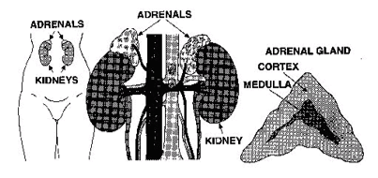
Adrenal Insufficiency Causes
Image credit: Congenital Adrenal Hyperplasia | Texas DSHS
Notes:
There are different causes of Adrenal insufficiency:
It can be genetic such as Congenital Adrenal Hyperplasia (CAH), that affects 1 in 15,000 infants (BCCH) . Affecting both boys and girls, these children lack an enzyme the adrenal gland needs to make cortisol and aldosterone. Another genetic condition that can cause of adrenal insufficiency is X-linked adrenoleukodystophy (ALD) or adrenomyeloneuropathy (AMN). This specific condition affects boys and men only.
Or it can be as a result of one of three different types of adrenal insufficiency: primary (adrenal), secondary (pituitary), and tertiary (hypothalamus). This type of adrenal insufficiency depends on whether the problem lies in the adrenal gland or is due to impairment of the hypothalamus and pituitary gland. For example, Addison's disease (also called primary adrenal insufficiency), affects approx. 1 in 10 000, This is where the adrenal glands themselves stop working - no cortisol is produced.

Slide 8
Role of Cortisol: it can help
The body respond to stress or danger
increase body’s metabolism of glucose
control blood pressure
reduce inflammation
Cortisol is also needed for the ‘fight or flight’ response, which is your healthy, natural response to perceived threats.
Notes:
As this slide suggests, cortisol has many important functions, acting on many different parts of your body.
It can help:
your body respond to stress or danger
increase your body’s metabolism of glucose
control your blood pressure
reduce inflammation
Cortisol is also needed for the ‘fight or flight’ response, which is your healthy, natural response to perceived threats.
https://www.mskcc.org/cancer-care/patient-education/give-emergency-injection-using-solu-cortef-act-o-vial

Slide 9
When Is Emergency Treatment Needed?
Notes:
Without enough cortisol, a person can go into adrenal crisis.. When this happens, an emergency injection of a cortisol medication called Solu-Cortef is needed.

Slide 10
Adrenal Crisis Triggers:
Common triggers include:
sudden onset of vomiting or diarrhea
a rise in body temperature above 38 C
serious accident or injury such as a broken bone
other infections (e.g. flu)
extreme emotional stress
An adrenal crisis is a life-threatening situation and requires immediate medical treatment with an emergency injection of hydrocortisone.
Presentation Title
10
Notes:
An adrenal crisis occurs when the cortisol present in the body is not sufficient to keep it functioning. It is a life-threatening condition.
These are the common triggers for an adrenal crisis, For reference, around 8% of people with Addison's disease experience an adrenal crisis each year; some people more frequently than others.

Slide 11
Adrenal Crisis Symptoms:
severe pain in back, abdomen, or legs that happens suddenly
weakness
vomiting
dehydration
diarrhea
confusion
loss of consciousness
Notes:
An adrenal crisis can cause symptoms that include the following:
.

Slide 12
Administering Solu Cortef
Notes:
Treatment for Adrenal Crisis is administering Solu cortef which is also known as hydrocortisone

Slide 13
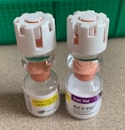
Training Supplies
Solu Cortef Act-O-Vial (trainer has white lid)
Alcohol wipes
Syringe and needles (23 G 1”, 1-3ml)
Cotton ball
Band-Aid (optional)
Sharps container (regular or empty hard-sided jug)
Hydrocortisone Injection Instructions (BCCH)
Notes:
Photo credit: B Marsman
ENDOCRINOLOGY & DIABETES UNIT (bcchildrens.ca)
https://www.mskcc.org/cancer-care/patient-education/give-emergency-injection-using-solu-cortef-act-o-vial

Slide 14
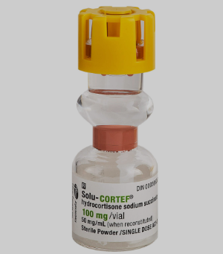
Solu Cortef
Trainer
Actual vial
Image credit: B Marsman
Image credit: Product Details | Pfizer Hospital
Notes:
Solu-Cortef (hydrocortisone sodium succinate) is a corticosteroid hormone (glucocorticoid) used to treat various conditions (such as severe allergic reactions, arthritis, blood diseases, breathing problems, certain cancers, eye diseases, intestinal disorders, and skin diseases). For our purposes, it is used in emergency situations for treating adrenal insufficiency in students.
We have practice vials which can be distinguished from the actual medication vials with their white caps.

Slide 15

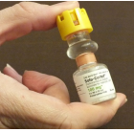
Treatment
Image credit: FS-Solu-Cortef.pdf (pituitary.asn.au)
,Image credit: https://www.nadf.us/uploads/1/3/0/1/130191972/nadf_solucortef_im_admin_training.pdf
Notes:
Solu-cortef’ s configuration is unique.
As you can see from the photos, it comes in a vial with a double-barreled chamber, the diluent is separated from the powder. To mix, one must press hard on the top cap as per the photo
This medication should be kept at room temperature, kept in its original box to keep dark, and there should be a system set up to ensure it is within the expiry date. Once reconstituted it is stable for 3 days. As of June 2024, the cost of a vial in BC is approx. $75.00
https://www.nadf.us/uploads/1/3/0/1/130191972/nadf_solucortef_im_admin_training.pdf

Slide 16
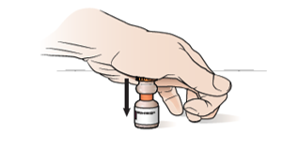
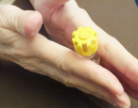
Steps in Administration
Image credit: https://www.mskcc.org/cancer-care/patient-education/give-emergency-injection-using-solu-cortef-act-o-vial
Image credit: https://www.nadf.us/uploads/1/3/0/1/130191972/nadf_solucortef_im_admin_training.pdf
Notes:
Let review administration.
First, start with clean hands
Firmly press down to force the diluent to the lower compartment, it is best to place the vial on a firm surface when doing this step.
If rubber stopper get stuck, and does not move into the lower chamber, tap the vial against palm of your hand.
BCCH handout suggests gently shaking the vial. Take are not to shake vigorously as the powder may get stuck to top of vial and not mix well. No lumps are wanted! Its best to gently rotate/swirl to mix into a clear liquid.

Slide 17
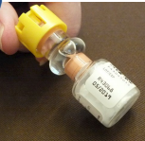
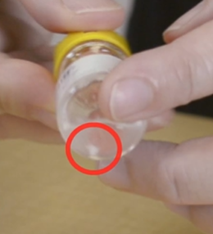
Check
Image credit: NADF SoluCortef IM Admin Training
Image credit: unknown, unable to find
Notes:
Be sure the medication has not expired.
Confirm the medication is completely mixed.
The Solution should be clear coloured, let it sit 1 minute to become CLEAR if needed. Foaming is normal.

Slide 18
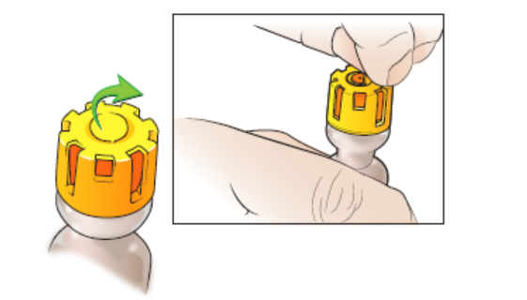
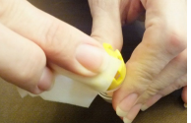
Image credit: https://www.mskcc.org/cancer-care/patient-education/give-emergency-injection-using-solu-cortef-act-o-vial
Image credit: https://www.nadf.us/uploads/1/3/0/1/130191972/nadf_solucortef_im_admin_training.pdf
Notes:
Remove the yellow tab on top of the vial as illustrated to reveal the orange stopper underneath.
Clean with the alcohol wipe to sterilize.
https://www.mskcc.org/cancer-care/patient-education/give-emergency-injection-using-solu-cortef-act-o-vial
https://www.nadf.us/uploads/1/3/0/1/130191972/nadf_solucortef_im_admin_training.pdf

Slide 19
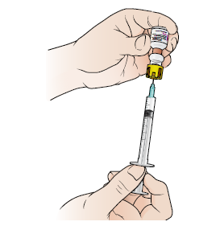
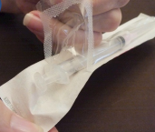
Image credit: https://www.nadf.us/uploads/1/3/0/1/130191972/nadf_solucortef_im_admin_training.pdf
Image credit: https://www.mskcc.org/cancer-care/patient-education/give-emergency-injection-using-solu-cortef-act-o-vial
Notes:
Open the syringe and needle packages (PHN to demonstrate how to maintain sterility), attach needle if not already attached.
22-25 gauge, 1” can be used, although 23 gauge was most often mentioned in the literature.
Discuss safety mechanism.
Draw air into the syringe to equal the amount of medication wanted (next slide).
Invert vial. Stick the needle into the middle of the rubber stopper, gently insert air from the syringe
Make sure the needle tip is in the liquid, to fill with medication and not air.
Gently pull the plunger back to fill the syringe with the medication in the vial, ensuring the correct dose.
Pull needle out of the vial.
Discuss air bubbles, moving vial to keep needle in the medication.

Slide 20
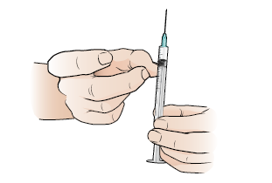
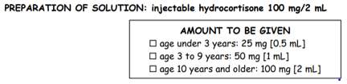
Image credit: https://www.mskcc.org/cancer-care/patient-education/give-emergency-injection-using-solu-cortef-act-o-vial
Notes:
Check the syringe for air bubbles, if any, hold syringe with needle pointing up and tap/flick syringe until air bubbles rise to top, near needle, Slowly push plunger up to force air bubbles out being careful not to expel medication. Don’t let air take place of medication.
Note the amount of medication to be administered.
Put cap back on syringe, place on clean surface
Find out if the parent has provided an extra needle to replace the one used to pierce the rubber stopper, if yes, use it.

Slide 21
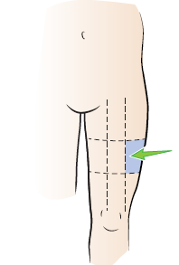
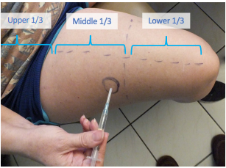
Image credit: https://www.mskcc.org/cancer-care/patient-education/give-emergency-injection-using-solu-cortef-act-o-vial
https://www.nadf.us/uploads/1/3/0/1/130191972/nadf_solucortef_im_admin_training.pdf
Notes:
Demonstrate how to landmark the injection area: Draw an imaginary line in middle of thigh to divide it in half lengthwise, the outer portion is where the injection will be administered, Now imagine the thigh divided into 3 equal portions, from the knee to the hip, the outer portion of the inner third of the thigh is the targeted area.
Best practice will be to inject into bare skin, as clothing may bend the needle or introduce bacteria. Scissors in the kit may help in the rare case clothing needs to be cut to access the injection area.
Teach to rub the alcohol swab in a circular motion, cover a larger area than will be needed, so that the staff can ensure they are giving the injection in a cleaned area. DO NOT rub back and forth, do not blow on it. The evaporation is what cleans the skin.

Slide 22
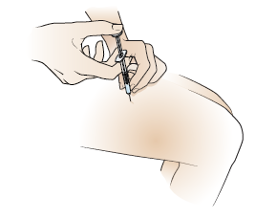
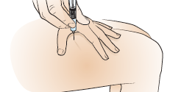
Image credit: https://www.mskcc.org/cancer-care/patient-education/give-emergency-injection-using-solu-cortef-act-o-vial
Notes:
Pick up needle, take off cap.
Hold syringe like a dart, keep thumb off plunger.
With other hand hold skin taut where needle is to be given.
Push needle straight into thigh, 90-degree angle, quick and dart-like.
Move thumb to plunger, inject medication at a slow, even rate.
Teach to keep needle in place for a count of 10 seconds so medication stays in the muscle.
Pull needle straight out rapidly and put in sharps container or some hard sided jug, labeled as such.
Cover with gauze and apply pressure for a few seconds, apply band aid if required.
Place student in the recovery position.
Effects last about 6 hours

Slide 23
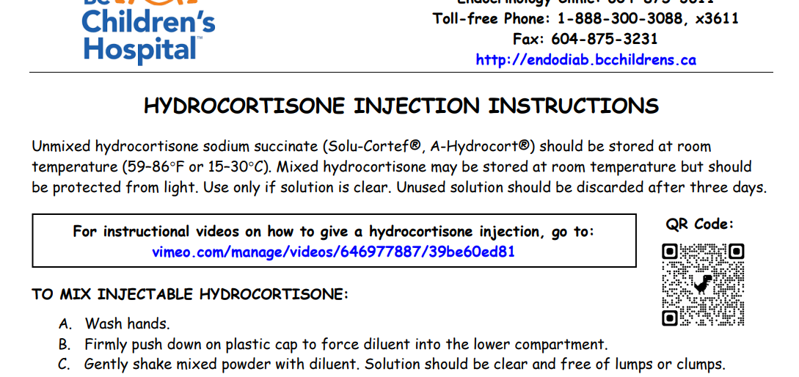
Notes:
This handout comes from the BC Childrens hospital and is a great reference for school staff, and links directly to a video on administration: ENDOCRINOLOGY & DIABETES UNIT (bcchildrens.ca)

Slide 24
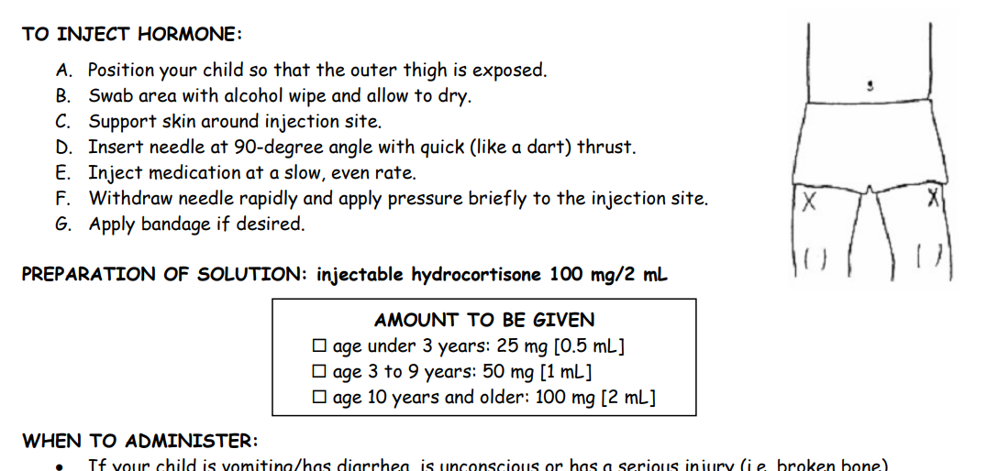
Notes:
This is the other half of the document It clearly lists dosage amounts which are also listed on the BCCH School letter (In slide 27, resources). NOTE: the photo of needle placement here is misleading, reinforce the correct location.
ENDOCRINOLOGY & DIABETES UNIT (bcchildrens.ca)

Slide 25

Practice
Image credit: istock
Notes:
As with any training, its always good to do a role play, or a walk-through to help solidify the learning.
An adrenal crisis is a life-threatening situation and requires immediate medical treatment with an emergency injection of hydrocortisone.
Have the staff walk through a role play of finding a student with one of the symptoms for adrenal crisis. Perhaps the parent can share a real-life example and how their child presented.
Symptoms:
severe pain in back, abdomen, or legs that happens suddenly
weakness
vomiting
dehydration
diarrhea
confusion
loss of consciousness
Ask
How do staff know who has adrenal insufficiency, how about substitute staff, or lunch time monitors?
Where is the kit located? Is there sharps container/ridged plastic jug with lid for needle disposal?
Who will call the parent or emergency contact?
Practice drawing up, landmarking the location, injecting.
What about post-injection care, do they know how to put the child into prone position, what to do if parent or emergency contact is not answering (call 911!).
Ensure there has been opportunity for practice

Slide 26
Resources
Notes:
Pictures used for this PPT have come from:
https://www.nadf.us/uploads/1/3/0/1/130191972/nadf_solucortef_im_admin_training.pdf
https://www.mskcc.org/cancer-care/patient-education/give-emergency-injection-using-solu-cortef-act-o-vial
B Marsman RN MN

Slide 27

Resources
BC Childrens Hospital Hydrocortisone Injection Instructions http://www.bcchildrens.ca/endocrinology-diabetes-site/documents/injcort.pdf
Instructional video https://vimeo.com/646977887/39be60ed81
School Letter for the Cortisol–Dependent Student http://www.bcchildrens.ca/endocrinology-diabetes-site/documents/cortschool.pdf
Notes:
Here is where the school letter can be found, as well as other helpful resources for school staff.

